Slide 3
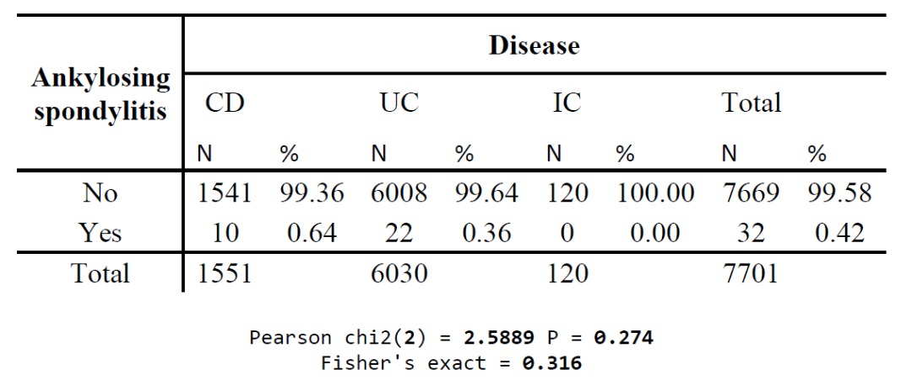
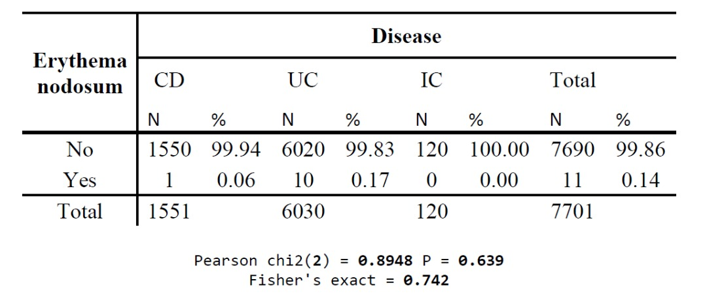
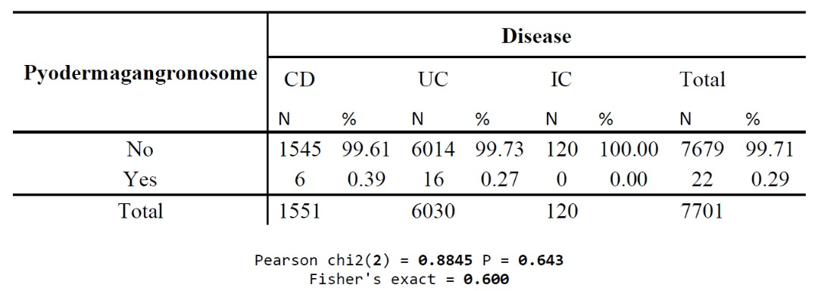
UC& EIM Data obtained from IRCC Registry

Slide 4
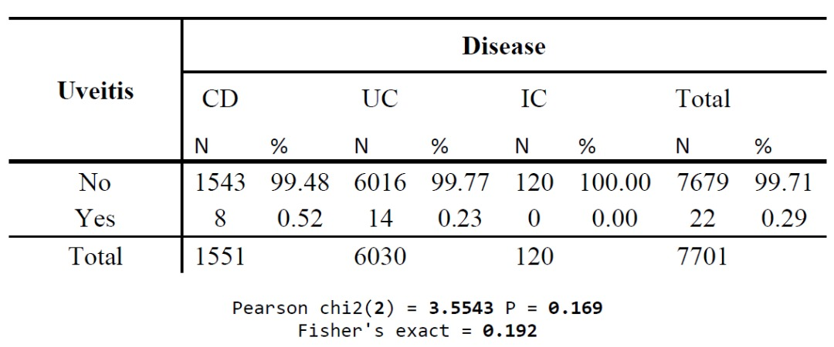
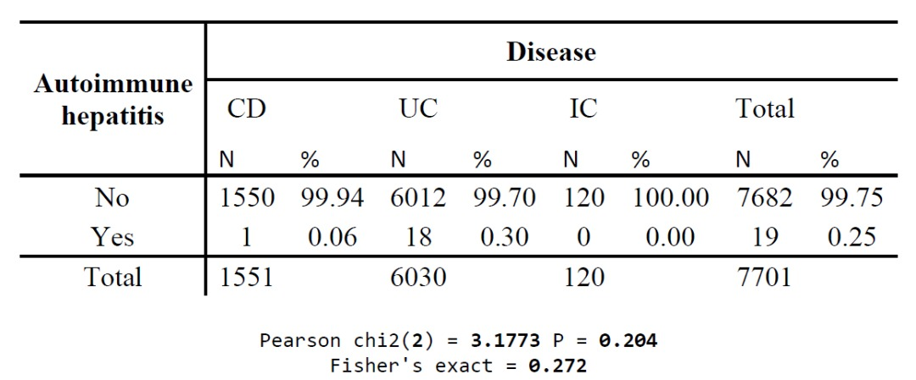
UC & EIM Data obtained from IRCC Registry

Slide 5
Case 1
38 years old lady KC of Ulcerative Colitis 1391
Presented with intermittent non bloody diarrhea, crampy abdominal pain, LBP, and migratory large joints arthralgia ( knee, wrist, ankle), and 3-4 kg weight loss
She have not history of GI bleeding, chest pain, and dyspnea
She said; in 1391 presented with diarrhea, and vomiting, and fever
After 2 weeks; vomiting and fever subside, but diarrhea continued
Hb; 12 CRP; 8 Ferritin; 34 LFT=Normal FBS; 88 Crt; 0.8 Stool; RBC, WBC neg
Her physician referred her for Colonoscopy
Colonoscopy; up to splenic flexure was seen, with decrease vascular marking (Mayo 1)
Rectosigmoid Biopsy; active inflammation
Her physician started 5ASA 3gr/d and after 2mo she did not respond to this medication

Slide 6
Q; 1
In patient with mild to moderate UC, how long do you wait for mucosal healing with 5ASA therapy?
1-Two weeks
2-One month
3-Two months
4-Three months

Slide 8
In 1392; she admitted to hospital due to bloody diarrhea, vomiting, abdominal pain, and LBP, and joints pain
WBC= 11220 ALT= 23 Hb= 11.6 AST= 22
ALP=287 Bili T= 0.7
Platelet= 761000 Bili D=0.2
CRP=12 Albumin=2.9 LDH= 385
AEA, TTG; neg
Colonoscopy; up to hepatic flexure were seen; decrease vascular marking with multiple erosion (Mayo 2)
Colonic Biopsy; CCDC
She discharged from hospital after 1 week with; 5ASA 3gr/d, prednisolone 20mg/d, AZA 100mg/d, and nortriptyline 25mg

Slide 9
Q; 2
You agree with this disease management?
1-Treatment is not correct
2-Evaluation is not correct
3-Education of patient is not correct
4-All of above

Slide 10
She was on prednisolone 10mg/d for 3 years, and discontinued the AZA due to nausea and vertigo, and 5ASA change with Sulfasalazine 3g/d
The patient presents with bloody diarrhea 4-5times daily, abdominal cramp, and large joint pain, LBP
Hb; 10.5 CRP; 45 LFT; Normal C-diff; Negative

Slide 11
Q; 3
What do you advise to her?
1-Colonoscopy
2-MRE
3-Prednisolone 50mg/d, 6-MP 50mg/d
4-Budesonide 9mg/d
5-Anti-TNF

Slide 14
Splenic flexure: Medium fungating ulcerative mass without active bleeding and stigmata (30 mm)
Transverse colon: Two small ulcerative mass without active bleeding (25mm)
Hepatic flexure: Medium fungating ulcerative mass without active bleeding (30mm)
Ascending Colon: Mucosa was erythematous , friable and granular
Cecum: Normal mucosa
ICV; Mucosa of was ulcerated
Terminal Ileum: Mucosa was erythematous

Slide 16
Ileal mucosa: No significant change
Transverse Colon: Exudate and Granulation tissue compatible with ulcer, fragments of colonic mucosa with focal active colitis
Fragments of colonic mucosa with focal crypt branching
IHC for CMV; negative
Only Chronic Crypt Destructive Colitis pattern

Slide 17
Q; 4
What is your best differential diagnosis for this patient?
1-UC with Backwash Ileitis
2-CD
3-Indeterminate Colitis
4-UC and malignancy

Slide 19
Indeterminate Colitis
IC is a temporary diagnosis
IC is not a purely microscopic diagnosis
IC was originally proposed for surgical samples operated with a suspicion of UC or CD but equivocal pathology
IC is diagnosed more widely and includes all cases with endoscopy, radiographic and histological evidence of IBD confined to the colon, but without fulfilment of diagnostic criteria for UC or CD
The incidence of IC is higher in the pediatric than in the adult population
The microscopic diagnosis implies the study of multiple biopsies from different segments of the colon
Three major patterns could be distinguished:
-total severe colitis;
-segmental disease with rectal sparing;
-and variation in the intensity of the disease in different parts of the colon
Current Diagnostic Pathology (2003) 9,179-187

Slide 20
Q; 5
What do you advise to her at first?
1-Repeat Colonoscopy (the last colonoscopy was performed one month ago)
2-MRE
3-Lumabr and Pelvic X ray
4-Continue sulfasalazine 3gr/d, and start Budesonide 9mg, and taper

Slide 22
Q; 6
Which one of following Rheumatologic manifestation is less common in IBD patients?
1-Arthritis Type 1
2-Arthritis Type 2
3-Arthralgia
4-Ankylosing Spondylitis

Slide 27
Q; 7
Which of following is the best diagnostic tool in patient with negative X-ray for Axial SpA in UC patient?
1-Pelvic MRI
2-HLA-B27
3-Bone scan
4-Physical examination

Slide 34
Q; 8
Which of following medications is more suitable for the treatment of LBP for UC patient?
1-Pentasa 3gr/d
2-ASACOL 800 TDS/d
3-Sulfasalazine 3gr/d
4-Non of above

Slide 35
Q; 9
How you treat this UC patient with Axial SpA:
1-Oral NSAID+ physical activity
2-Oral sulfasalazine
3-Increase dose of AZA
4-Subcutanous MTX
5-Anti-TNF

Slide 38
Q; 10
Which disease phenotype in IBD patients, the EIMs are more common?
1-Terminal Ileum involvement
2-Colon involvement
3-Ileo-colon involvement
4-Upper GI involvement

Slide 42
She did not any follow up up to 3years
The patient have some times bloody diarrhea, and abdominal cramp, and suddenly due to temporomandibular joint pain, LBP, pelvic pain, and legs pain admitted to hospital Rheumatology ward, and her Rheumatologist consulted with Gastroenterology ward
The patient is on Prednisolone 10mg/d, sulfasalazine 3gr/d, and some times NSAIDs
Q; 11
What do you advise at first?
1-Colonoscopy
2-MRE
3-Plain abdomen
4-Bone scan

Slide 46
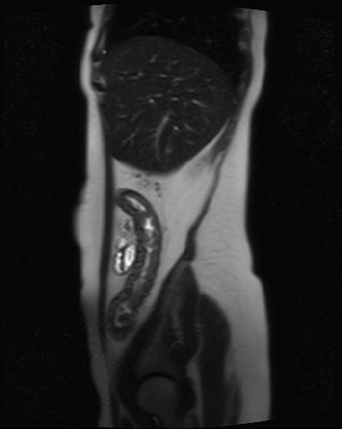
MRE
Long segment of circumferential with mild mural thickening is seen in right colon from cecum to hepatic flexure
Two segments of mural thickening are evident in transverse and proximal descending colon
Short segment with mild mural thickening is evident in terminal ileum within 10-15cm length with mildly increased contrast enhancement
The rest of small bowel is unremarkable

Slide 47
lab
WBC= 15140 AST=20 Hb= 8 ALT=8 Platelet=465000 ALP=151 BUN=11 Bili T= 0.5 Cr=0.51 Bili D= 0.35 Na=142 ESR=80 K=3.86 CRP=34
Serum Albumin= 3.1

Slide 48
Q; 12
What do you advise to her?
1-Hydrocortisone 100mg TDS for 3-5 days, and followed by prednisolone 50mg/d, and sulfasalazine 3gr/d
2-Infliximab 5mg/gr 0,2,6, and every two months, and 6-MP, Sulfazalezine3g/d
3-Infliximab 5mg/gr 0,2,6, and every two months, and MTX 25mg/week, folic 5mg/d
4-Adalimumb 160/80/40 EOW, and MTX 25mg/week, folic 5mg/d
5-Tofacitinib 10mg/BD, Sulfazalezine3g/d

Slide 50
After 3-4months; she is on Infliximab every two months, and MTX 15mg/w, folic 5mg/d
The patient has not LBP, and Joint pain, but she have some times non bloody diarrhea
Hb; 12 CRP; 16 ESR; 22 LFT; Normal Ferritin; 59 Fecal Calprotectin; 289

Slide 51
Q; 13
What is your Treat To Target strategy in this patient?
1-At least every 3 months until symptom resolution
2-At least 6-12 months after symptom resolution
3-Colonoscopy or MRE with in 6-9 months after start of therapy
4-1&3
4-All of above

Slide 52
Treat-To-Target: STRIDE Recommendations

Slide 62
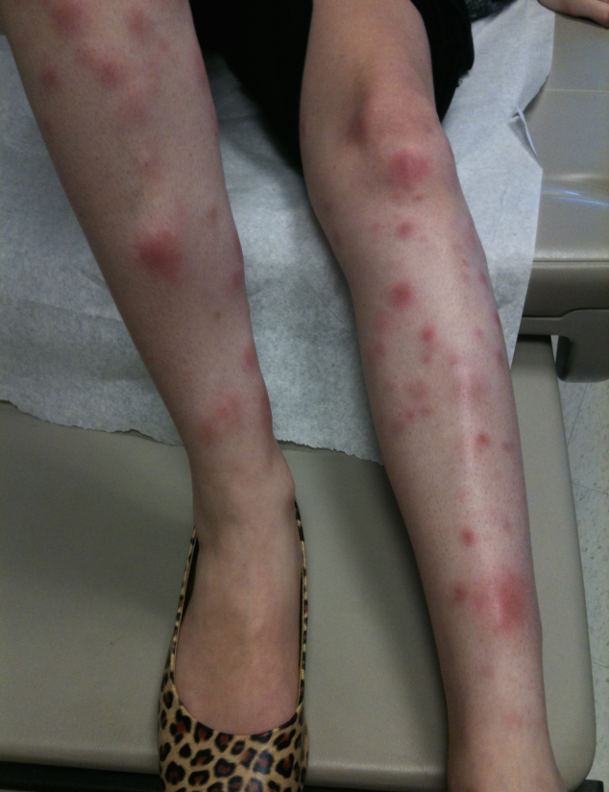
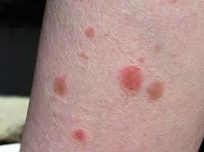
Case 2
43 years old woman with UC
History of left sided UC since 10 years ago at age 33
She is smoker and drinker
She responded to IFX then anaphylaxis
Poor response to 6-MP
She is on sulfasalazine 3gr/d

Slide 63
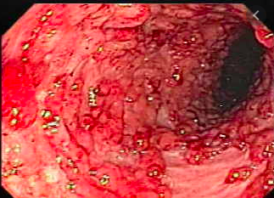
She presents with bloody diarrhea, 7-8 times daily, and nocturnal bloody diarrhea low grade fever, abdominal cramp, skin lesion with pruritus
Hb=10.1 ESR=45 CRP=49 Stool=WBC and RBC many

Slide 64
Q; 1
What is your best differential diagnosis?
1-Pyoderma Gangrenosum
2-Erythema Nodosum
3-Psoriasis
4-Sweet’s Syndrome

Slide 68
PAEs have been reported during biological treatment for chronic immune mediated diseases
A wide range of PAEs have been reported including:
-multiple sclerosis
-dermatological (psoriasis), Hidradenitis
-intestinal (Etanercept; anti-TNF-α, associated with the development of paradoxical IBD)
-ophthalmic (Uveitis rarely occurs; and exacerbated during IFX treatment), and scleritis, mainly with anti-TNF-α agents
Other PAEs may be qualified as borderline include;
-Sarcoidosis, or other granulomatous disease, vasculitis, vitiligo, alopecia areata
Toussirot É, Aubin F. Rheumatic& Musculoskeletal Disease Open 2016
Gastroenterol Hepatol. 2017 Feb;40(2):117-121
BMJ Open Ophthalmology 2019

Slide 70
Q; 2
What do you advise in this patient?
1-IFX
2-ADA
3-Tofaticitinb
4-Prednisolon
5-Ustekinumab
6-Prescribe a topical steroid

Slide 72
Back to case; She used 2-3mo topical steroid, stopped IFX, and the skin lesions did not respond to topical steroid, and bloody diarrhea continue Hb=10.7 ESR=34 CRP=44
Q; 3
What do you advise to her:
1-Stope IFX, and start Tofacitinib
2-Stope IFX, and start Adalimumab
3-Stope IFX, and start Ustekinumab
4-Low dose IFX, and start systemic Prednisolone
5-Stope IFX, and start Vedolizomab

Slide 75
Take Home Message
EIMs can occur before or during the course of IBD
We need to ask specifically for EIM
EIM should be considered when deciding on an IBD treatment
Find partners in Rheumatoloy, Dermatology you will need them
After musculoskeletal system, dermatological manifestations are the EIMs more frequently associated with IBD
About third of patients have skin lesions during the disease
In some cases skin lesions precede GI symptoms, but often appear subsequently
There is no strict correlation between the activity of the disease and the onset/ severity of skin symptoms

