Slide 1
Inflammatory Bowel Disease
Assessment and Challenges

Slide 2
1-Assess disease Activities
2-Assess Response to Treatment
3-Patient,s Values and preference

Slide 3
Inflammatory bowel disease (IBD)
Crohn’s disease and ulcerative colitis,
chronic inflammation with relapsing
progressive, immune-mediated inflammatory
With irreversible bowel damage

Slide 4
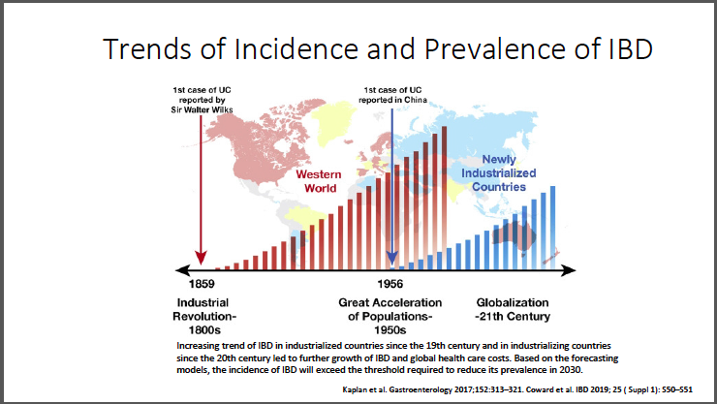

Slide 5
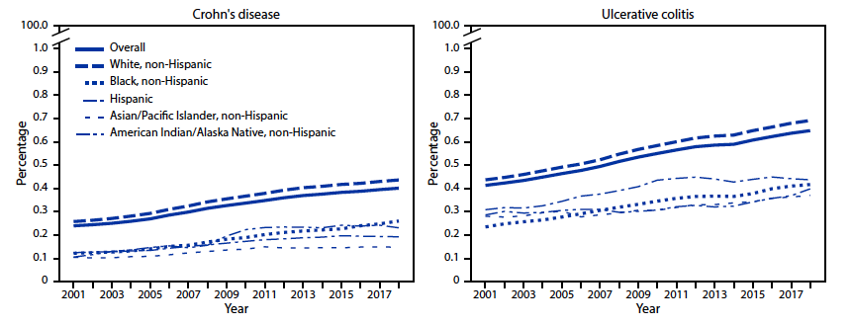

Slide 8
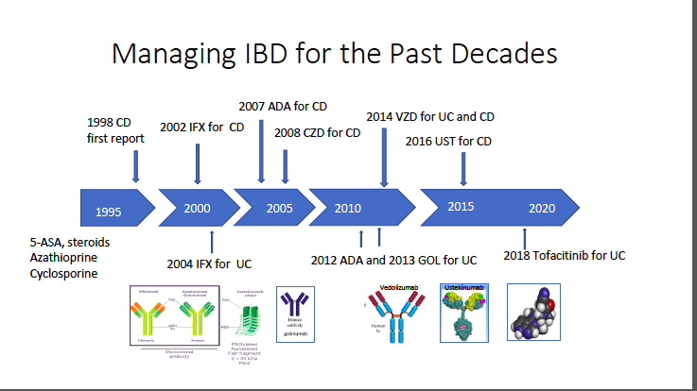

Slide 9
Goals for managing patients with IBD
(i) induction of remission
(ii) maintenance of remission
(iii) maintaining a steroid-free remission.
(iv) Reflect the patient’s and provider’s goals and recognize
the chronic nature of the disease
(v) Decrease hospitalization and surgery
(vi) Prevent complication
(vii) Improve patient Quality of life

Slide 10
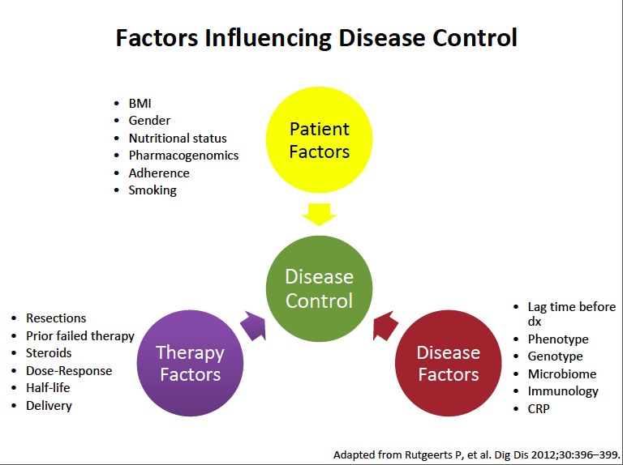

Slide 11
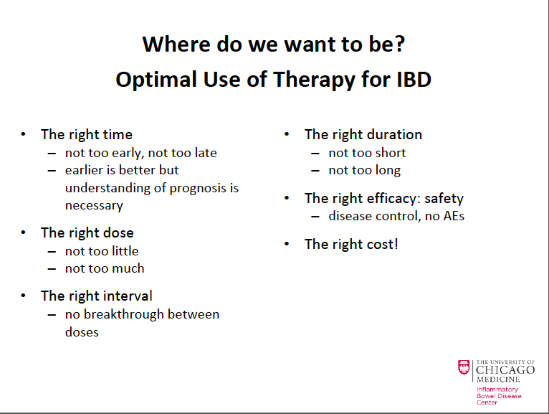

Slide 12
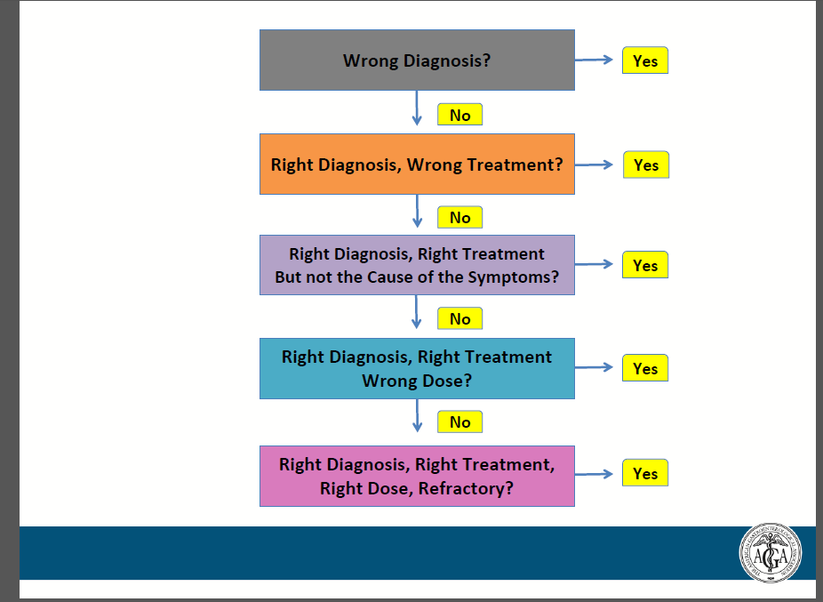

Slide 13
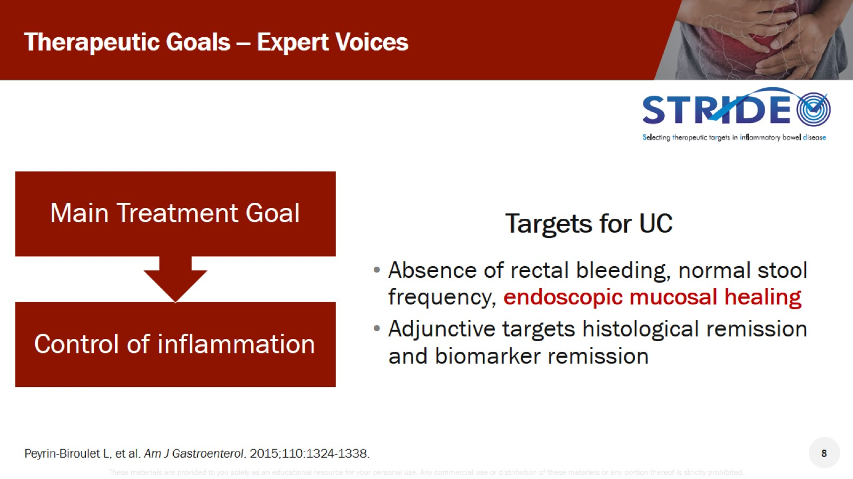
Therapeutic Goals -- Expert Voices

Slide 15
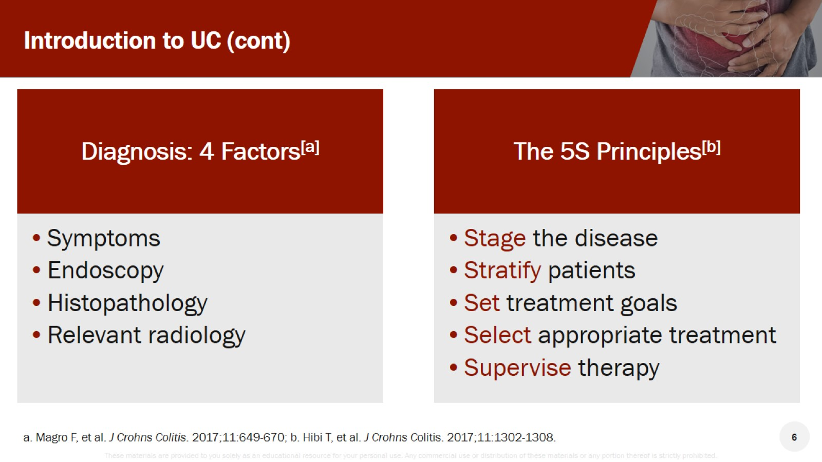
Introduction to UC (cont)

Slide 16
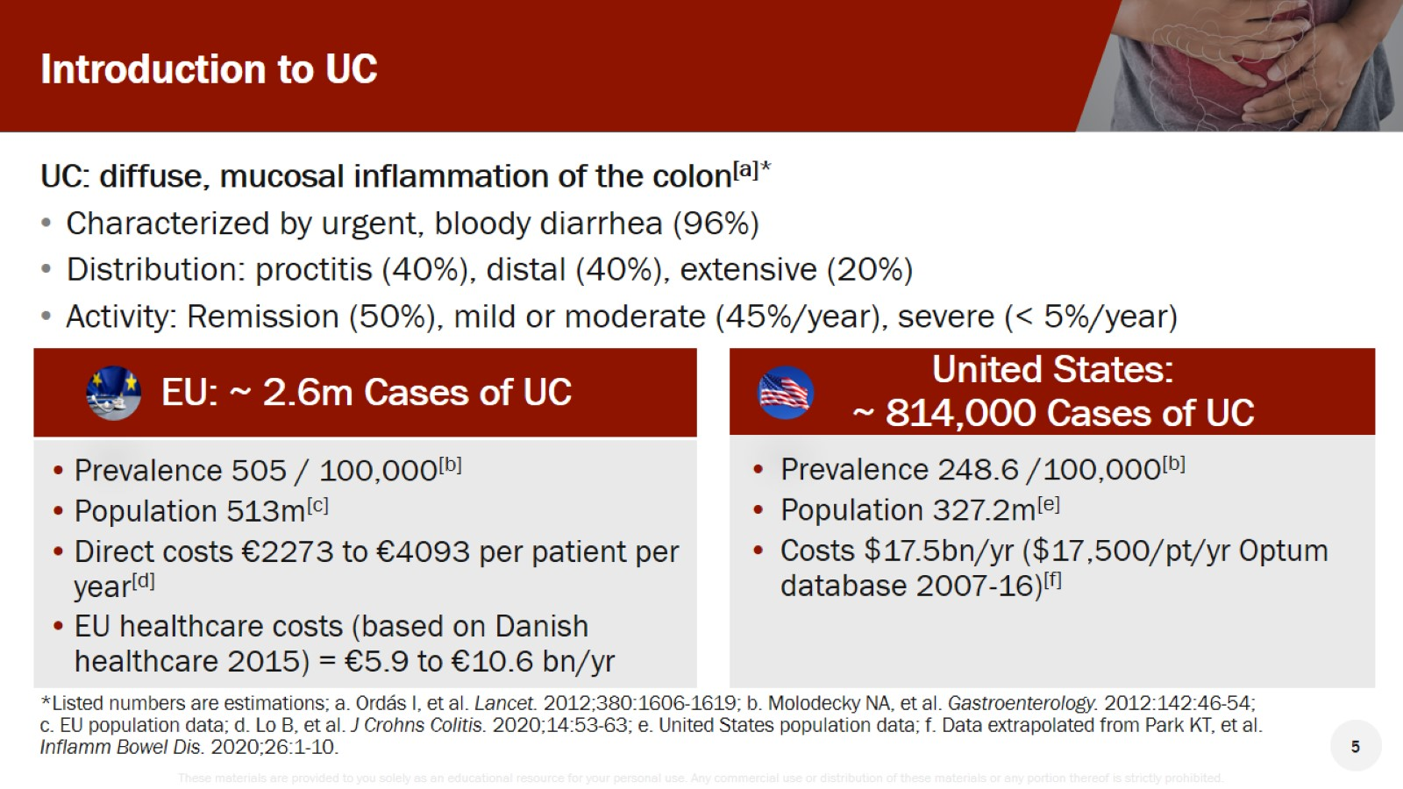
Introduction to UC

Slide 17
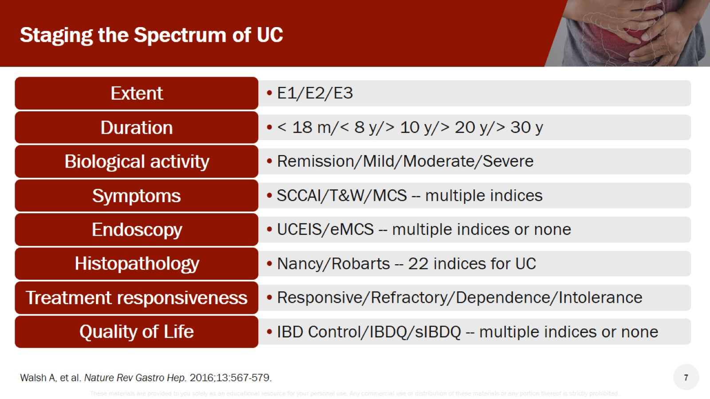
Staging the Spectrum of UC

Slide 18
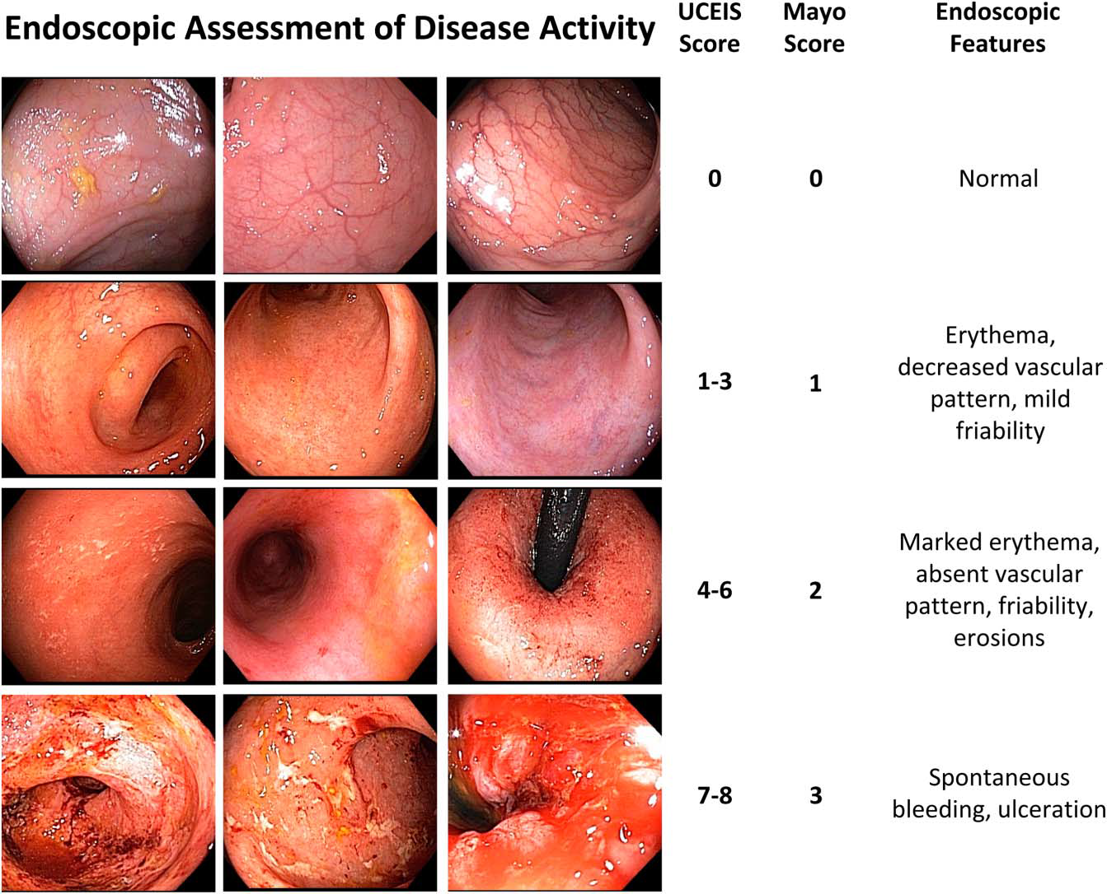

Slide 20
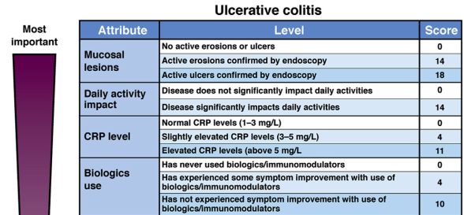

Slide 21
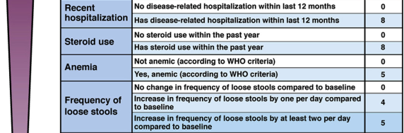

Slide 22
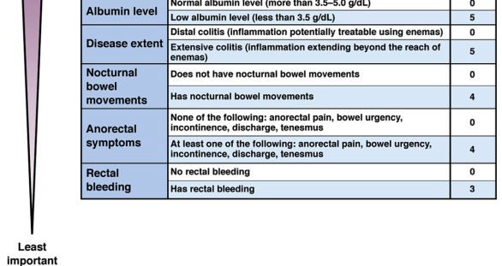

Slide 27
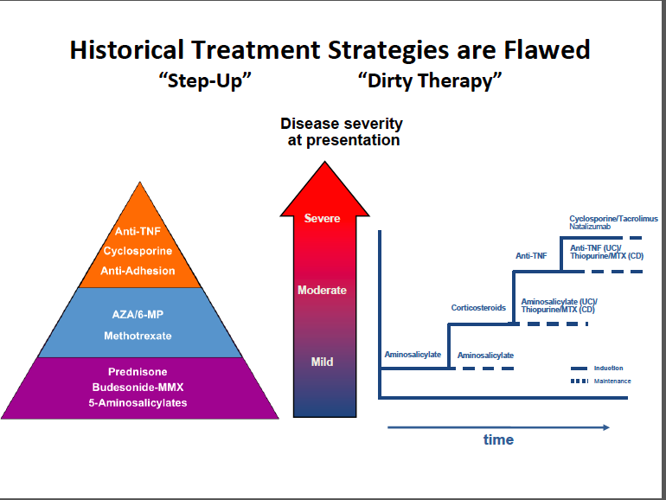

Slide 28
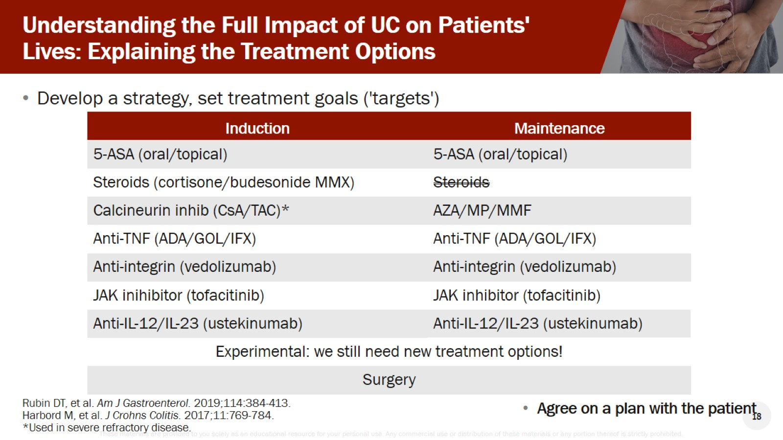
Understanding the Full Impact of UC on Patients' Lives: Explaining the Treatment Options

Slide 29
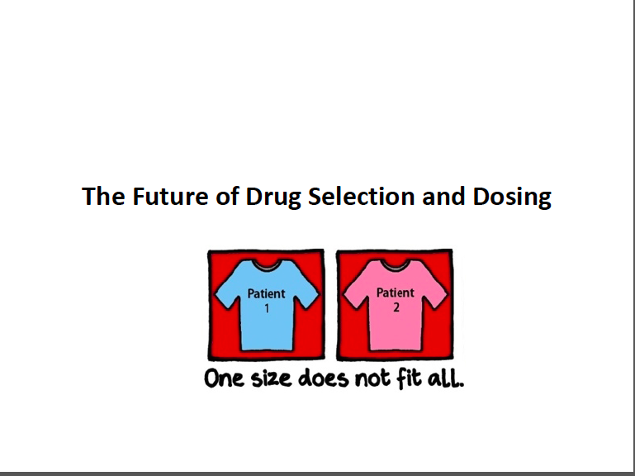

Slide 30
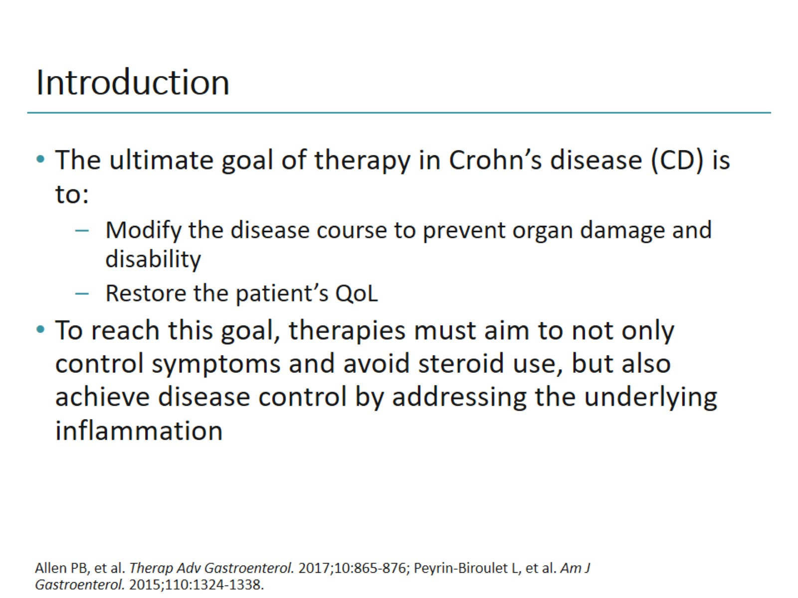
Introduction

Slide 34
Perianal Disease
Common complications of Crohn’s disease,
Associated more often with Ileal CD
Difficult to diagnose/manage.
Patients suffer from persistent pain and drainage,
Perianal sepsis, impaired quality of life, and financial burden.
Conventional medical and surgical therapies
carry risk of infection, myelo-suppression,
incontinence, recurrence.
EUS becoming popular because of low cost and ability to
acquire images in real time.

Slide 35
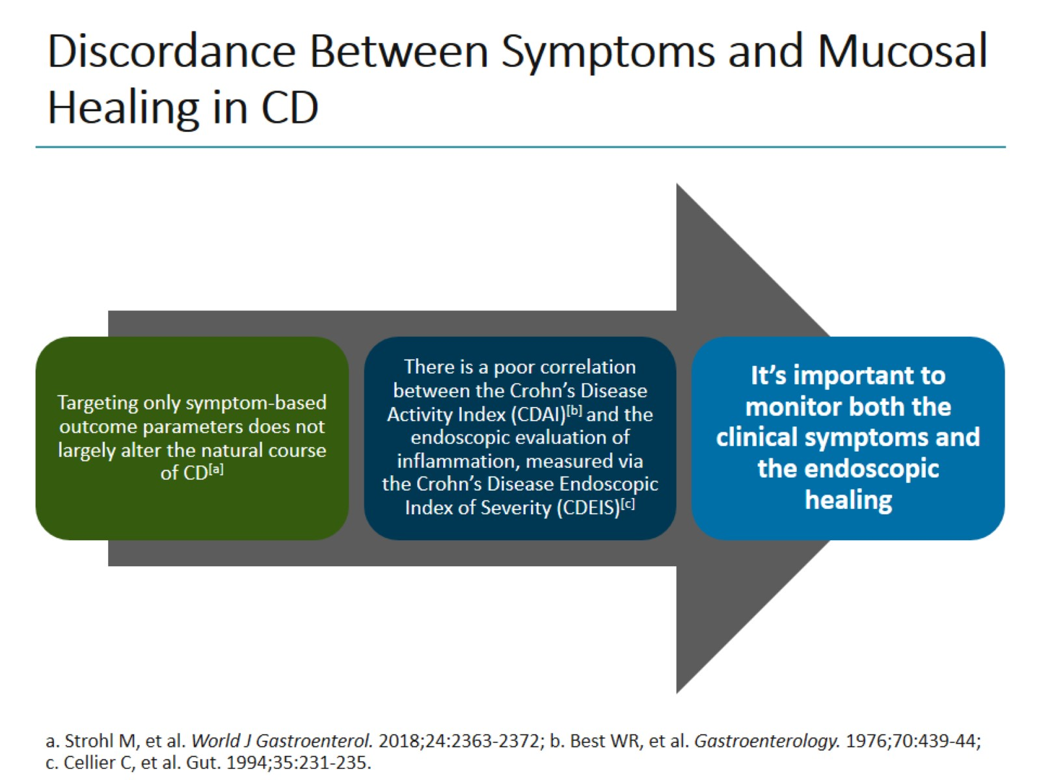
Discordance Between Symptoms and Mucosal Healing in CD

Slide 36
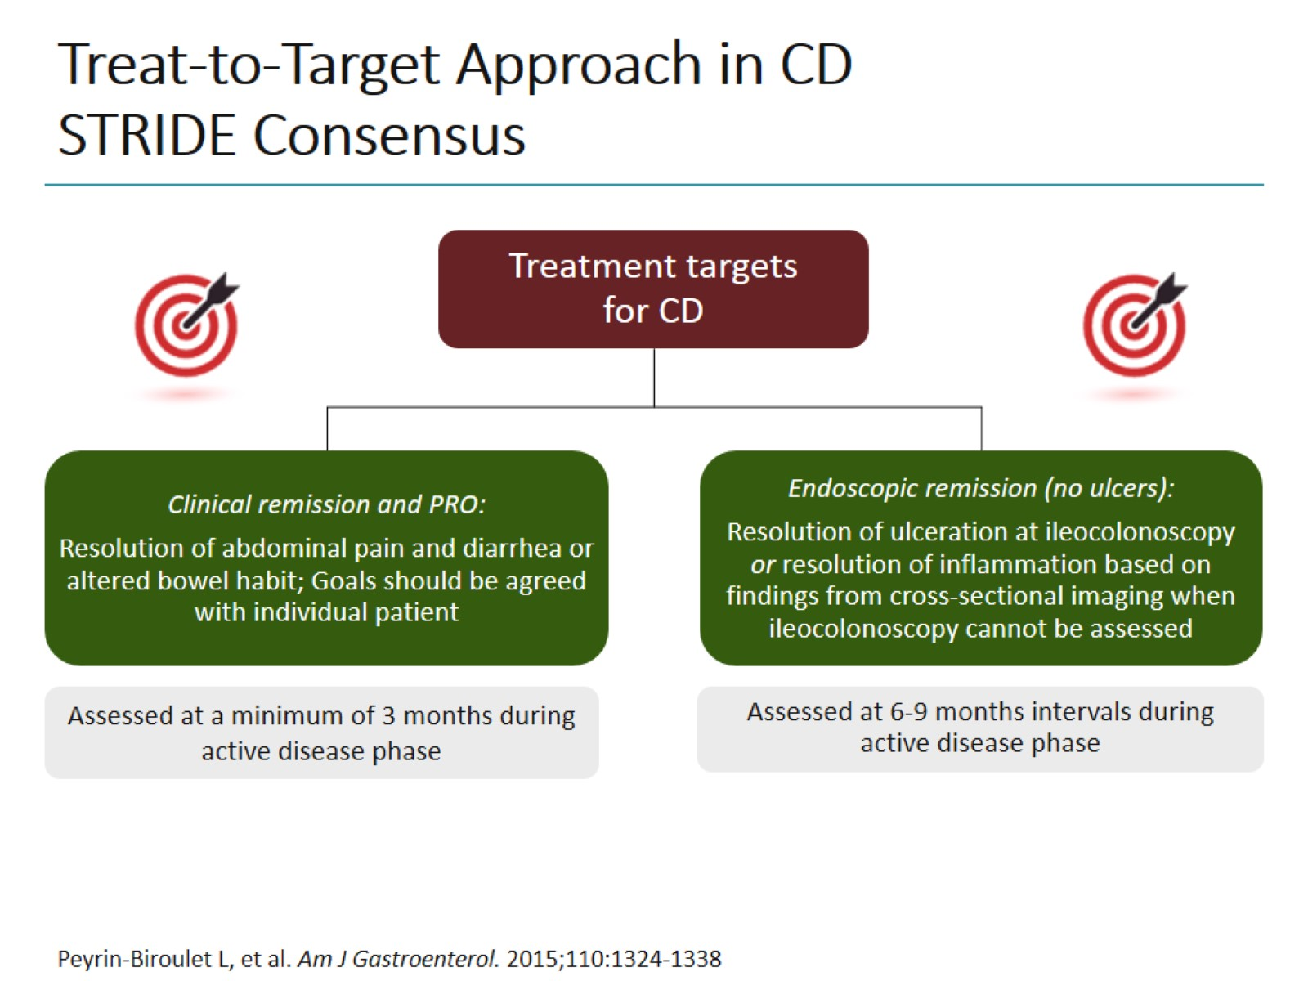
Treat-to-Target Approach in CD
STRIDE Consensus

Slide 37
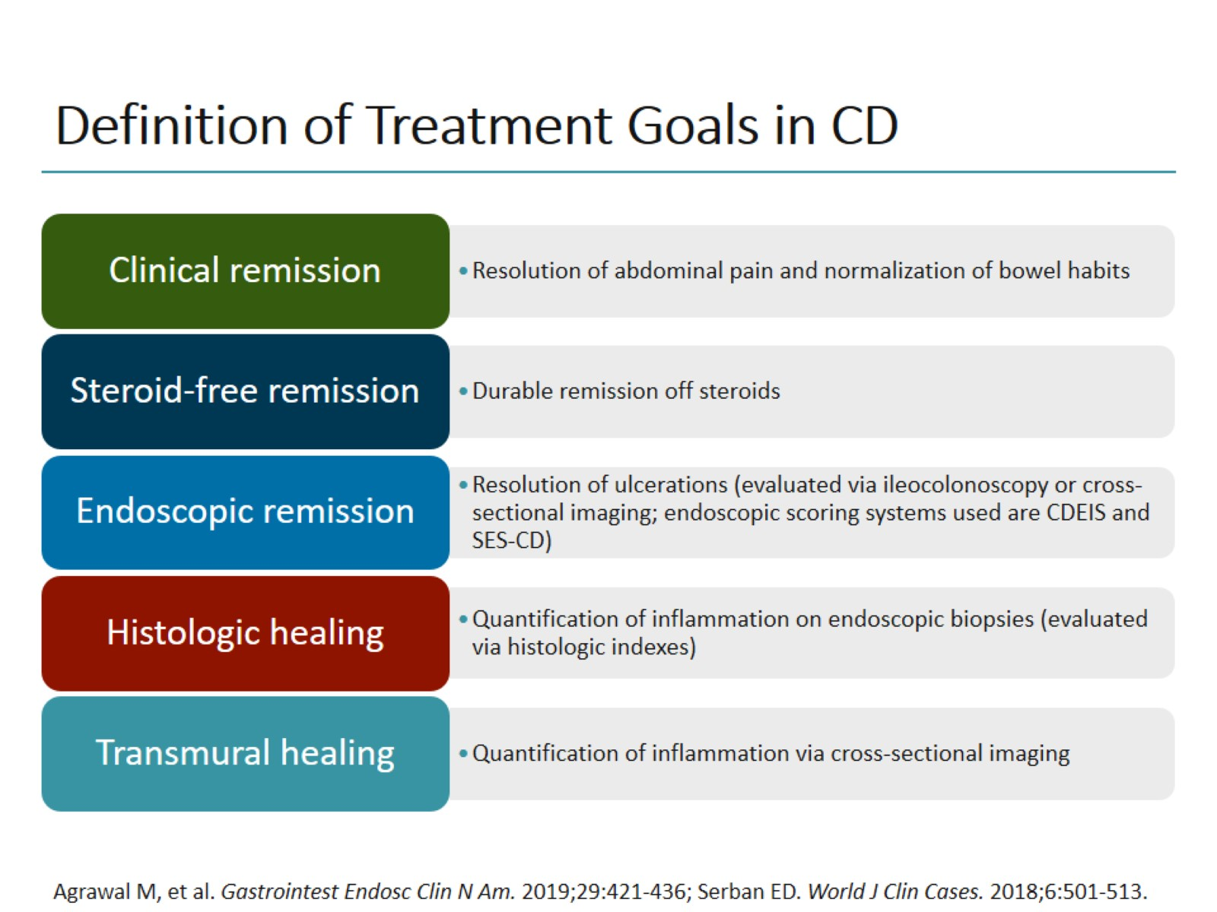
Definition of Treatment Goals in CD

Slide 38
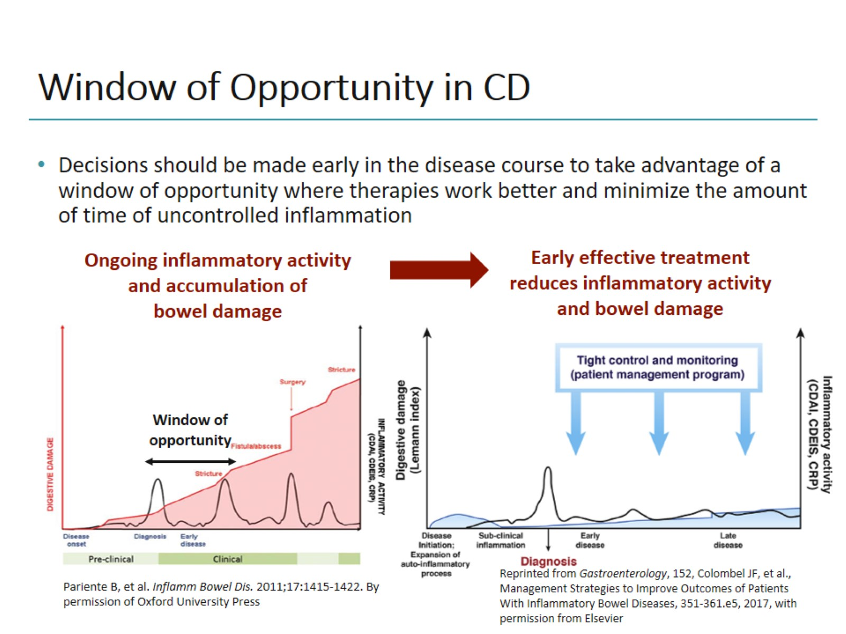
Window of Opportunity in CD

Slide 39
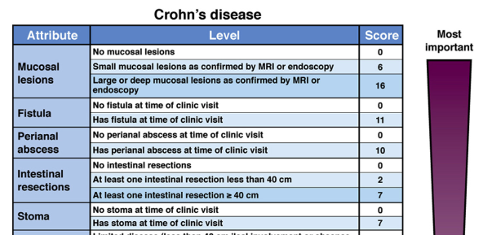

Slide 40
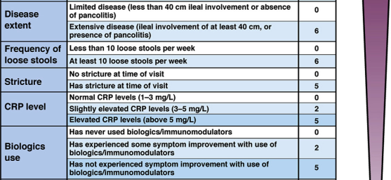

Slide 41
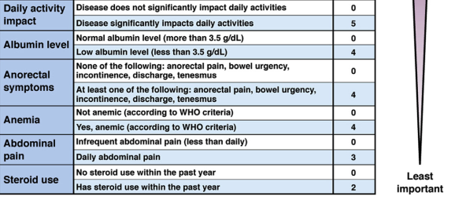

Slide 44
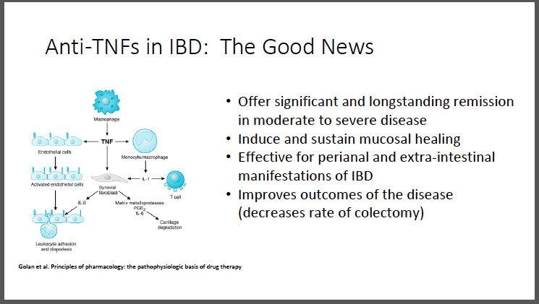

Slide 45
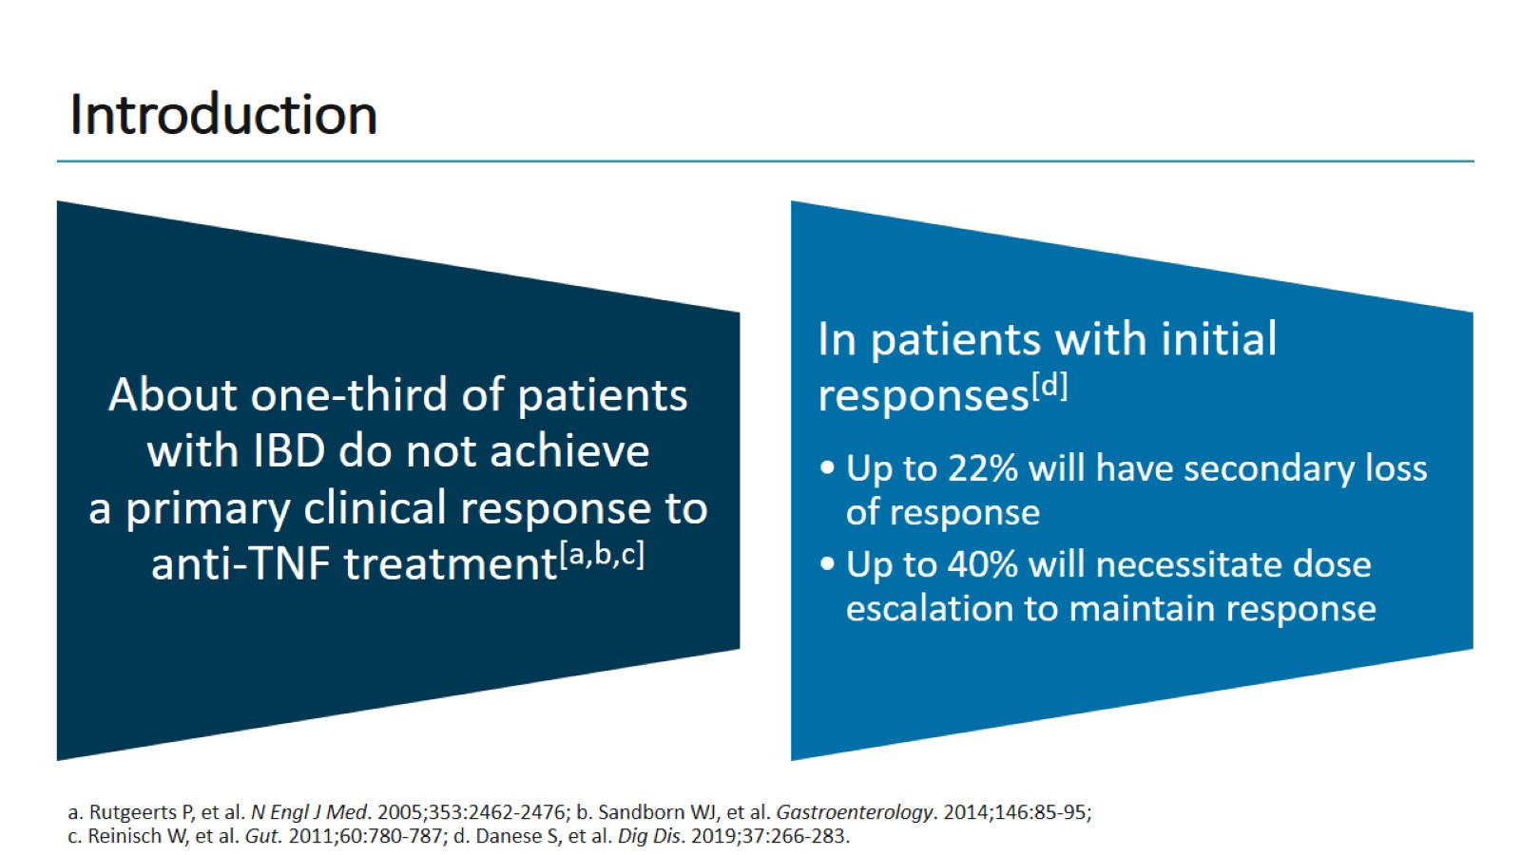
Introduction

Slide 46
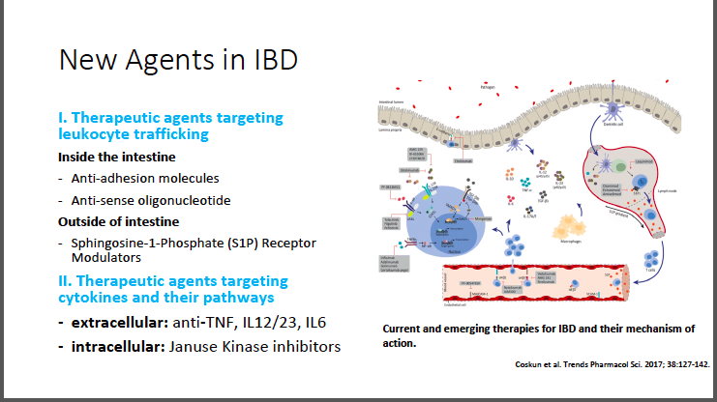

Slide 47
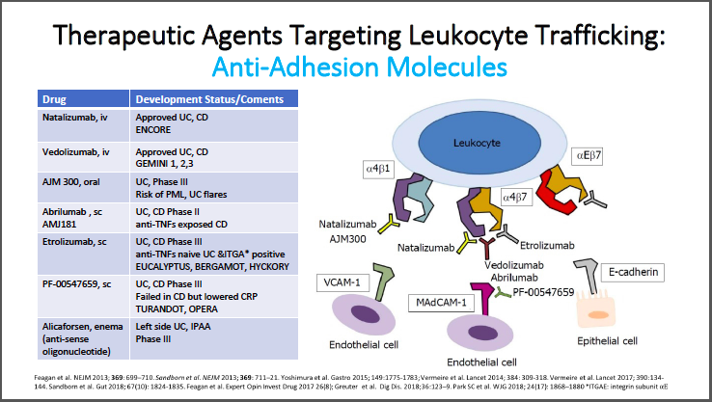

Slide 48
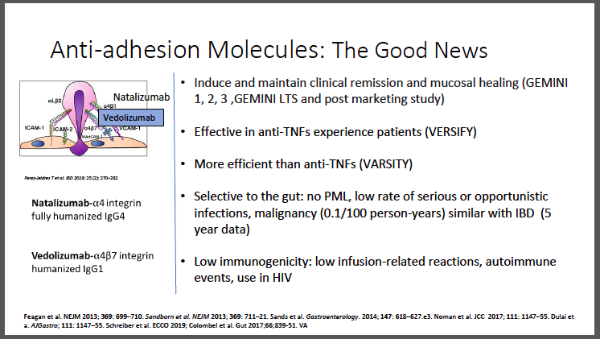

Slide 49
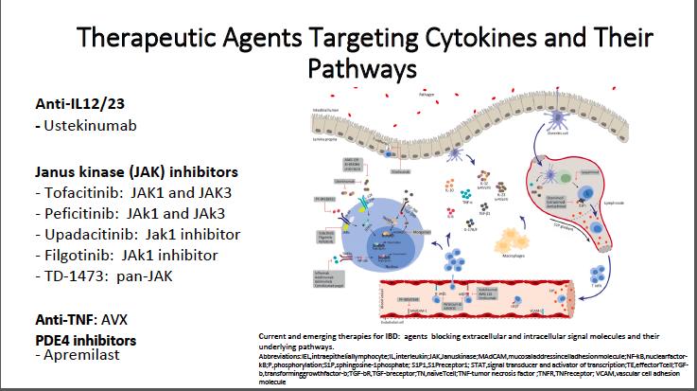

Slide 50
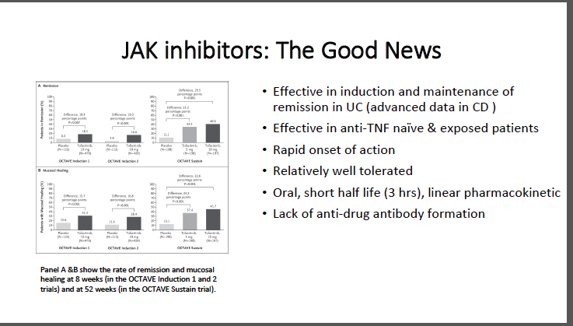

Slide 51
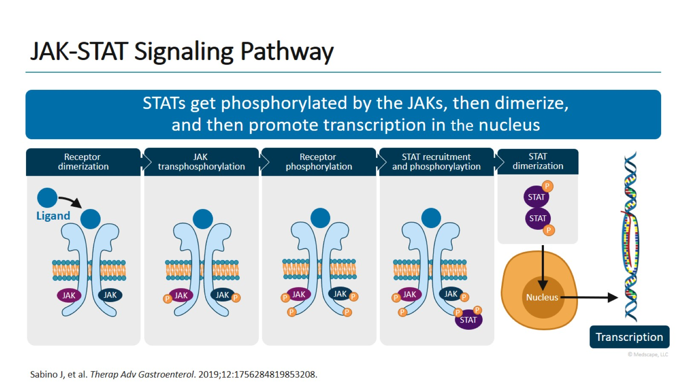
JAK-STAT Signaling Pathway

Slide 52
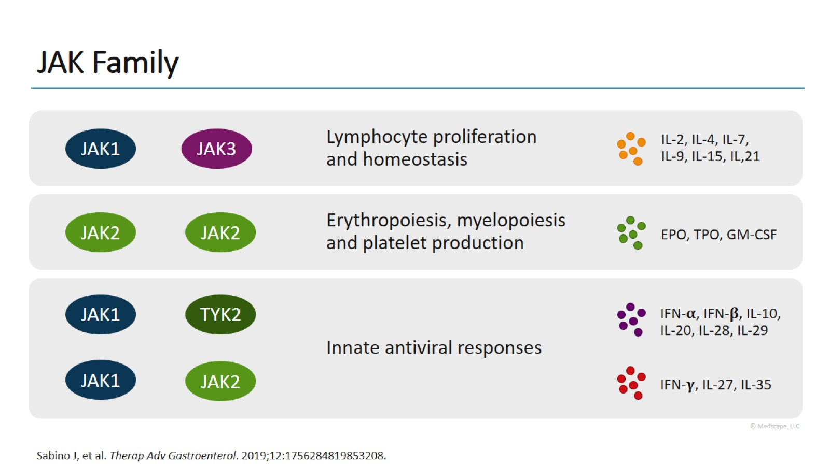
JAK Family

Slide 53
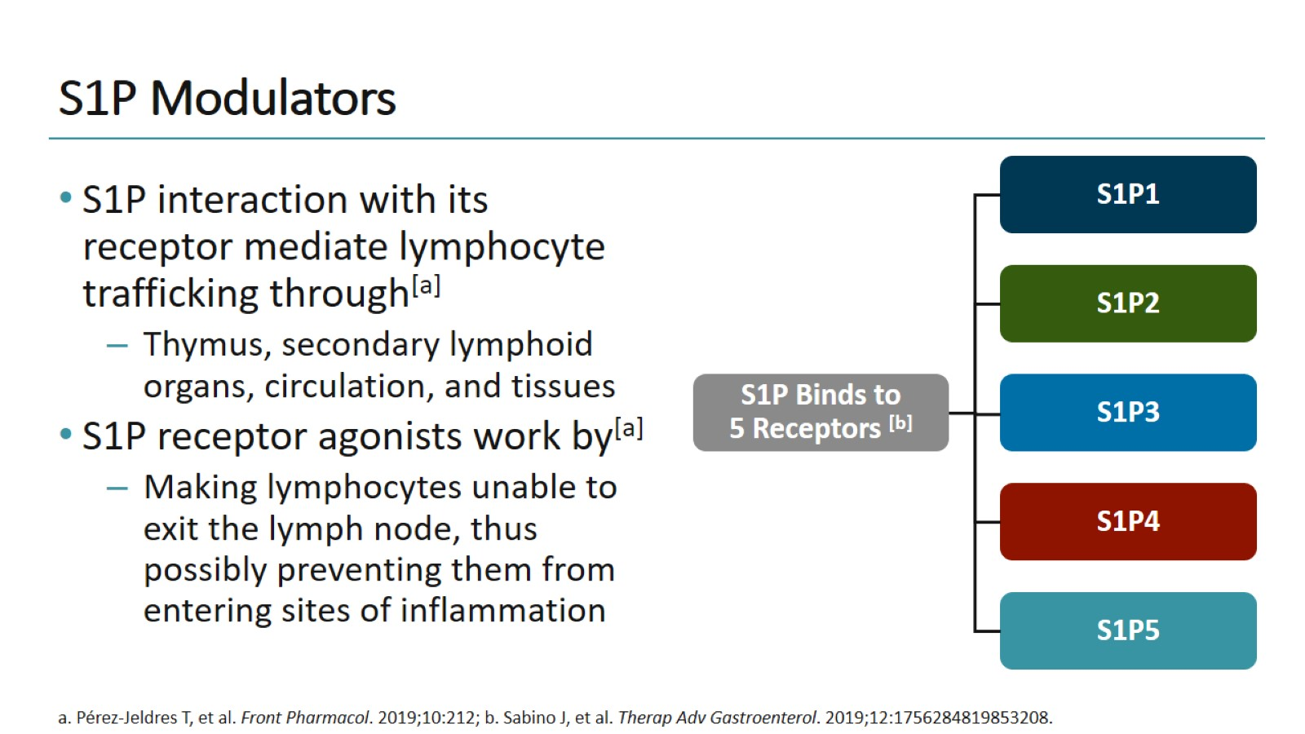
S1P Modulators

Slide 54
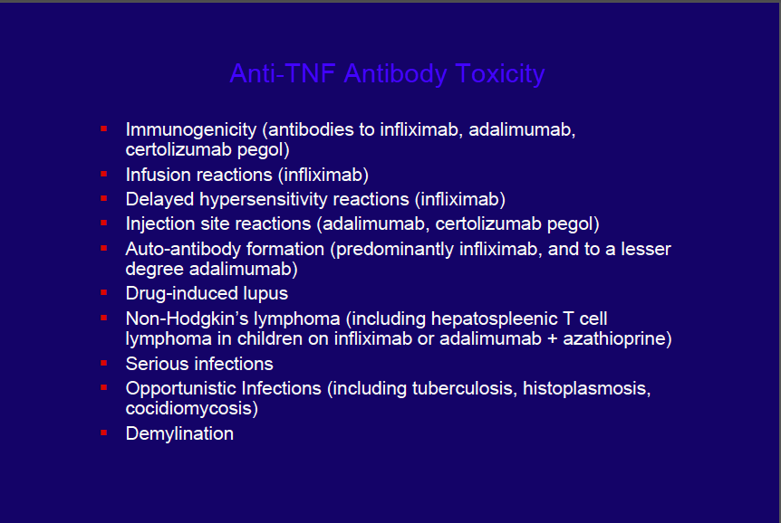

Slide 55
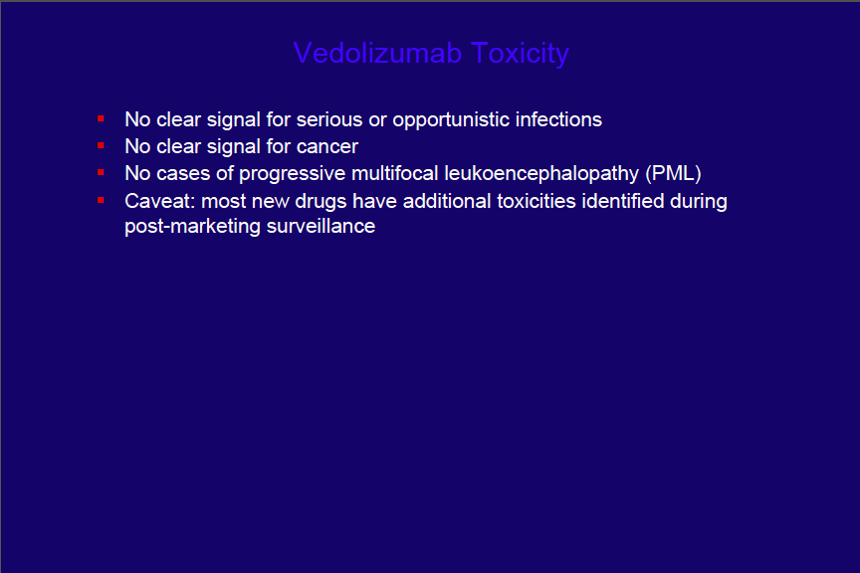

Slide 56
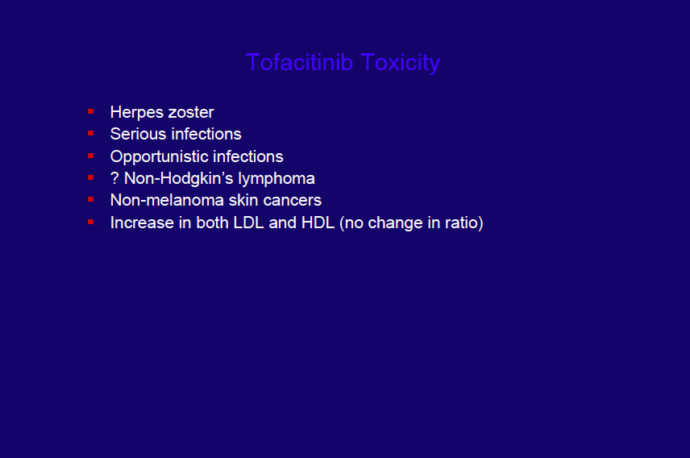

Slide 57
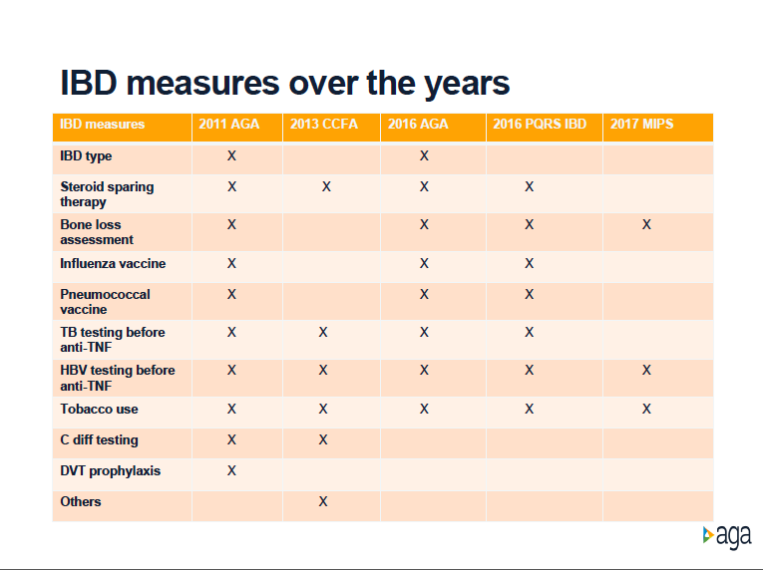

Slide 58
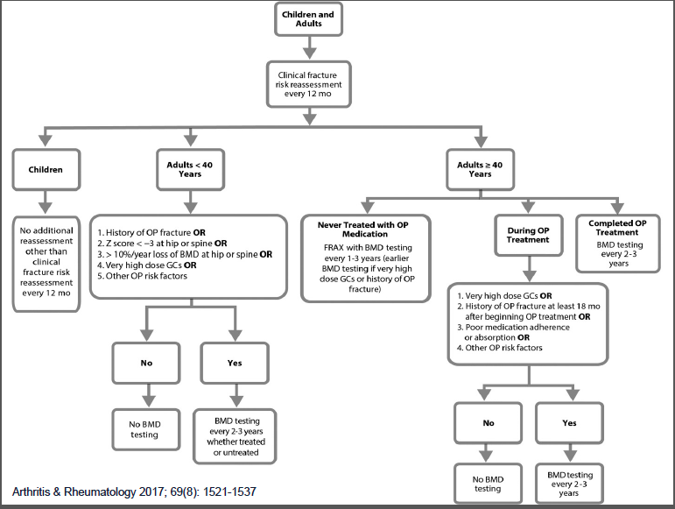

Slide 60
Advice to At-risk Individuals for Prevention of IBD
Breastfeeding in infancy for at least 6 months;
Do not start smoking
Avoid vitamin D deficiency
Minimize nonsteroidal anti-inflammatory drug use
Minimize antibiotic use especially for young children and during pregnancy
Minimize food that contains emulsifiers or any form of food additives
At least moderate physical activity,
regular sleep, low stress, healthy weight
Diet high in fruits, vegetables, fiber, and fish or oil

Slide 61
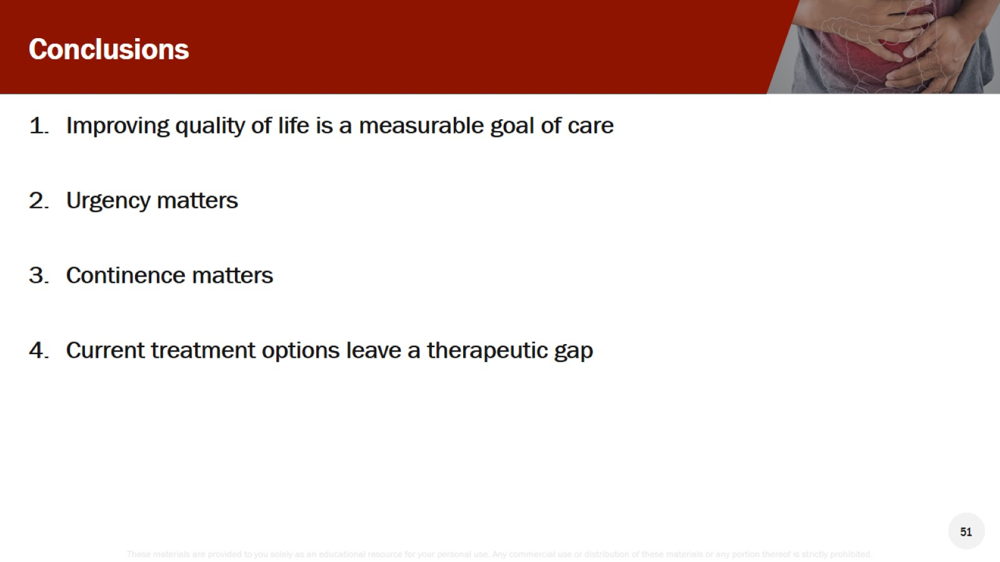
Conclusions

Slide 62
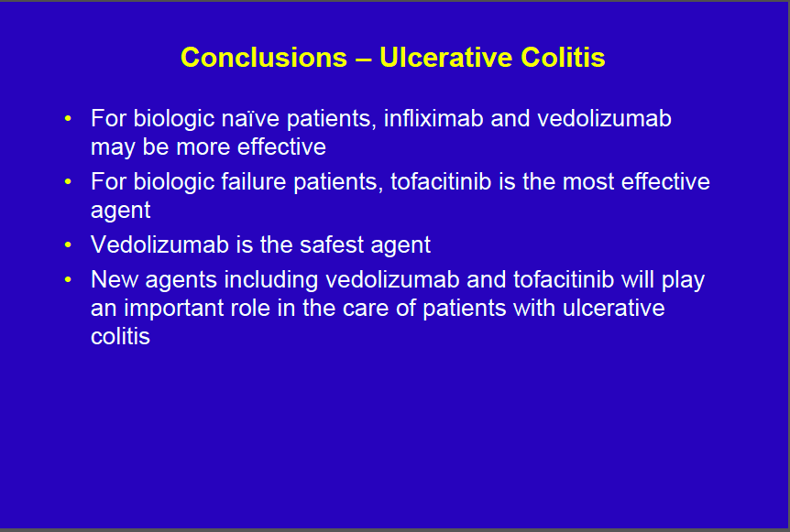

Slide 63
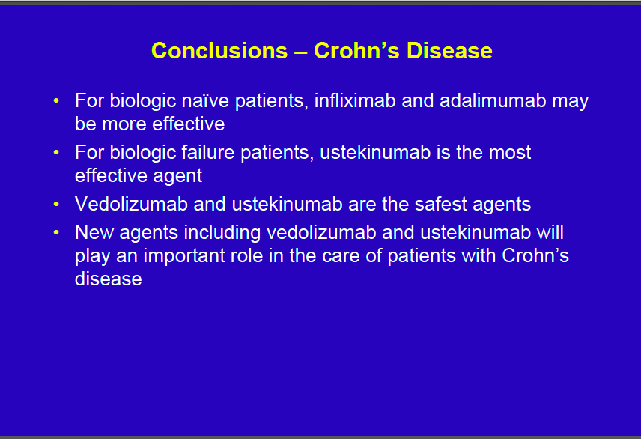

Slide 64
