Slide 1
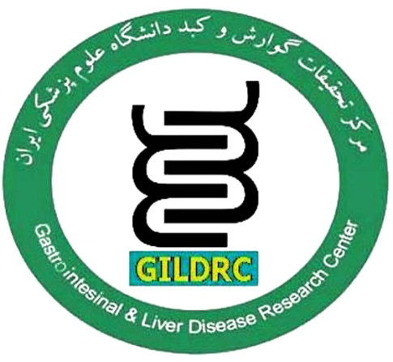
Hepatobiliary Complications in IBD ; a Brief review
Farhad Zamani MD
Professor of medicine
GastroIntestinal and liver Diseases Research Center
Iran University of Medical Sciences
spring2021

Slide 2
Introduction:
The IBD may involved extra GI system
IBD associated with idiopathic chronic or recurring immune activation and inflammation that can affect many organ systems including liver
Approximately 5% of adults with IBD have developed chronic liver disease
The strongest associated disease with IBD is PSC
less frequent IBD-associated hepatobiliary disorders include : cholelithiasis, steatosis, hepatic amyloidosis, granulomatous hepatitis, PV thrombosis, liver abscess ,PBC and Pancreas disorders

Slide 3
Hepatobiliary Disorders During IBD
The pathogenesis of IBD-associated liver disorders is unclear.
Immunological, genetic and environmental factors may contribute to the pathogenesis and correlation between IBD and hepatobiliary manifestations
They may appear at any time point during the natural course of the disease
Range from a mild transient elevation of liver enzymes to liver failure and death

Slide 4
Hepatobiliary manifestations of IBD
The manifestations can be categorized as:
disorders that have an association with IBD
diseases directly and structurally related to intestinal inflammation
diseases related to the adverse effects of IBD treatment
disorders stemming from the metabolic derangements caused by IBD

Slide 5
Abnormal hepatic biochemistries were found in 29% of IBD
PSC in 4.6%
The prevalence of abnormal LFT was 27% for those with active IBD and 36% for those in remission (P= 0.06).
Patients with abnormal LFT were less frequently on 5-aminosalicylates
Risk of death was 4.8 times higher in patients with abnormal LFT
Conclusions:
Abnormal LFT were present in nearly one-third of patients, and surprisingly, they were not associated with IBD activity.

Slide 6
A Cross-sectional study in Brazil 2014-2016 306 pt. enrolled
Hepatobiliary manifestations were observed in 19.6%
In UC 18.2% patients: 6.7% NAFLD, 5.5% cholelithiasis 3.6% PSC, 1.8%hepatotoxicity with azathioprine.
In CD 21.3% patients: 7.8% had cholelithiasis, 7.8% NAFLD, 2.8% PSC, 2.1% hepatotoxicity
The most common nonspecific hepatobiliary manifestations in IBD patients were NAFLD and cholelithiasis
The most common specific hepatobiliary disorder was PSC

Slide 7
Approach to elevated liver enzymes in patients with IBD
In IBD, Liver enzyme levels are routinely obtained
It should be specifically requested for those who complain of pruritus, abdominal pain, jaundice or malaise
Blood test interpretation in IBD needs cautions

Slide 8
Common Hepatobiliary disorders in IBD

Slide 9
A stepwise approach for the evaluation of abnormal LFT in patients with IBD

Slide 10
PSC
PSC is closely associated with IBD mainly with UC
Three-quarters of patients with PSC have UC
Approximately 4% of UC may develop PSC
PSC occurs in middle age with 2:1 male predominance
The estimated incidence rate of PSC is 0.77 per 10⁵ person-years and the prevalence is 8.5 to 13.6 per 10⁵ persons
PSC is associated with more extensive but less active UC

Slide 11
PSC
Incidence: 0.9-1.3 cases/100000
Prevalence: 1-14 cases/100000
Male predominance (60-70%), 4th decade
Association with IBD: 60%-90% PSC
Associated with a variety of neoplastic and non-neoplastic (dominant stricture ) hepatobiliary complications.
Developing cholangiocarcinoma (CCA), reaching 400–1500 times higher risk than the general population
The median liver transplantation-free survival for patients with PSC is approximately 15-20 year
World J Gastroent Endoscop. 2019 Feb 16; 11(2): 84–94
Liver Res . 2019 Jun;3(2):106-117;
Hepatol Commun. 2016;1:7–17

Slide 12
Complications
CCA is frequently diagnosed within the first 1 - 3 years after diagnosis of PSC
Incidence of colorectal cancer is increased in patients with IBD and PSC compared to people with IBD alone
cancer risk remains even after liver transplantation
Gallstones, cholecystitis and gallbladder mass lesion are other complications of IBD and PSC in 25%, 25% and 5% respectively
World J Gastroenterol. 2015 Feb 14; 21(6):1956-71; World J Gastroenterol. 2017;23(14):2459–2469;

Slide 13
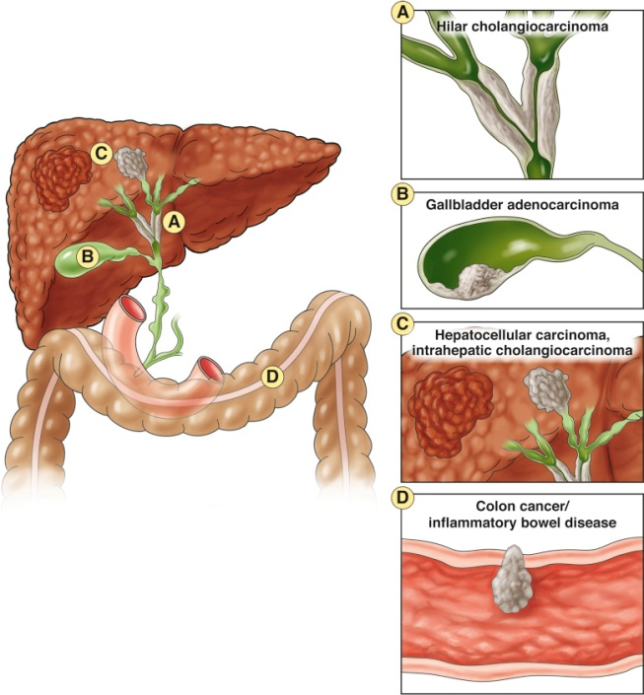
Malignancies associated with PSC.
1-PSC is Strongly associated with GI malignancy
2-There is no evidence-based algorithm for surveillance of PSC for cancers
3-Cancer surveillance with interval Ultrasound, MRI, Colonoscopy, EUS ,lab data (CA19-9)as appropriated

Slide 14
CHOLELITHIASIS
The relationship between IBD especially CD and cholelithiasis is known since the 1970s.
People with CD have double the risk for the development of gallstones (11% to 34%) but in UC is same as general population
The risk of cholelithiasis increase after ileal resection in CD as with resections >30 cm are associated with an OR of 7, bile concentration may involved in this setting
Other risk factors for cholelithiasis in CD include: age, duration of disease, number of clinical recurrences, number of hospitalizations and TPN
JPGN2017;64: 639 – 652; J Dig Dis. 2015;16(11):634–641.

Slide 15
IgG4-Associated Cholangiopathy
It is a multisystem fibroinflammatory disorder
The diagnosis relies on elevated serum IgG4 levels (> 135 mg/dL) and histopathologic findings
It has been reported in patients with UC or CD
It responds to corticosteroid therapy, although relapse occurs in more than 40% of patients
An increased IgG4 level has been observed in 9% of patients with PSC
Gastroenterology Rese 2018 Apr; 11(2): 83–94.; J Crohns Colitis. 2011;5(5):451–456
Am J Gastroenterol. 2006;101(9):2070–2075

Slide 16
NAFLD
NAFLD has a wide histological spectrum
IBD patients develop NAFLD with fewer metabolic risk factors than non-IBD patients with NAFLD
The pathogenesis of NAFLD in patients with IBD is not yet clearly elucidated
Dysbiosis of the gut microbiome, long‐term use of medications (i.e., glucocorticoids) and duration of IBD may involved
hypertension (OR = 3.5), obesity (OR = 2.1), small bowel surgeries (OR = 3.7) and use of steroids at the time of imaging (OR = 3.7) were independent factors associated with NAFLD and is less frequent in patients receiving anti-TNF
Inflamm Bowel Dis 2019;25:124‐133;
Hepatology 2018;67:328‐357

Slide 17
PBC
PBC is associated with various autoimmune diseases
IBD, particularly UC, can be accompanied by PBC.
The etiology is unknown
The prevalence of PBC among patients with UC is higher than in general population.
Patients with PBC and UC are younger and more often males
UC is usually mild and left-sided

Slide 18
AIH /PSC overlap syndrome
Overlap syndrome Known as Autoimmune Sclerosing Cholangitis.
AIH/ overlap syndrome has been reported in IBD, especially with UC.
More frequent in childhood population
Patients having clinical, biochemical, serological and/or histological overlap findings of PSC and AIH.
prognosis may be better as compared to PSC alone
Treatment including immunosuppressive, UDCA,OLT
Gastroenterolog Res 2018 Apr; 11(2): 83–94,
JPGN2017;64: 639 – 652

Slide 19
Portal Venous Thrombosis
IBD is associated with increased risk of vascular complications : VTE & ATE
Patients with IBD may have elevated platelet counts, fibrinogen, and factor V and VIII levels.
There is also a concomitant d decrease in antithrombin 3 levels
It is mainly occurs in UC
Patients with UC during a flare phase carry eight times higher the risk for thromboembolism
Inflammation is the main factor and recent abdominal surgery, younger age, and female sex are associated with a higher incidence of PVT
Crohns Colitis2011;5:287–94; Am J Gastroenterol2007;102:174–86

Slide 20
Hepatic Amyloidosis
Occurs in less than 1% in IBD, more often in CD than in UC (0.9-3% vs. 0.07%)
Amyloidosis is more frequent in males and the mean age of diagnosis is 40 years.
Amyloidosis is associated 4.4 times more frequently with CD of the colon than with pure small bowel disease
Treatment is to control the underlying IBD that decrease the release of the acute phase reactant serum amyloid A
Anti-TNF may reduce the synthesis of amyloid precursors but can also decrease the formation of amyloid deposition
Aliment Pharmacol Ther. 2014;40(1):3–15.

Slide 21
Liver Abscess
Liver abscess is a rare complication of IBD, mainly CD.
The mechanism of liver abscesses development is not well-known
DM, ERCP, abdominal surgery, long-term treatment with steroids, fistulizing disease, intra-abdominal abscesses and malnutrition are probable predisposing factors to developing liver abscess
Liver Int. 2016;36(1):136–144.

Slide 22
Pancreatic disorders
Pancreatic disorders are not uncommon in patients with IBD.
The most frequent manifestation is acute pancreatitis
Causes of AP are mainly a concomitant biliary lithiasis or drugs used in the treatment of IBD.
Idiopathic IBD ­related pancreatitis also reported

Slide 24
Drug-Induced Hepatotoxicity
Steroid: hepatic enlargement, induction or worsening NAFLD
Aminosalicates: hepatocellular damage, cholestasis injury, granulomatous hepatitis, fulminant hepatitis , Abnormal LFT in 2%
AZA and 6-mercaptopurine :
Hepatotoxicity is dose-dependent and dose-independent
Hypersensitivity, idiosyncratic and endothelial cell injury.
Hepatotoxicity usually mild and asymptomatic rise of LFT
The risk of hepatotoxicity is higher in males and in CD
Frontline gasterology 2019;10:309–315. Aliment Pharmacol Ther2014;40:3–15; Best Pract Res Clin Gastroenterol2010;24:157–65;
Gastroenterology Research and Practice2012

Slide 25
Drug-Induced Hepatotoxicity
Methotrexate
MTX associate with hepatotoxicity through cumulative dose dependent mechanism and may cause steatosis, liver fibrosis and cirrhosis
cumulative dose of MTX is about 1.5 - 2 g
Obesity, alcohol ,DM are considered as risk factors
World J Hepatol. 2017;9(13):613–626;Inflamm Bowel Dis. 2014;20(1):47–59

Slide 26
Drug-Induced Hepatotoxicity
Anti-TNF-a agents
These can rarely cause liver damage, most often infliximab
Liver injury can occur irrespectively of the number of infusions or injections, dose or time.
The anti-TNF-a agents can cause from mild abnl. LFT to acute hepatitis with hepatocellular or cholestatic pattern
Most times, hepatitis has autoimmune features with anti dsDNA antibodies
The mechanism of hepatotoxicity is unknown

Slide 27
Hepatobiliary Complications in IBD

