Slide 1
Role of echocardiography in Acute aortic syndrome(AAS)
Dr Pourkia
Associated Professor of Babol University of Medicine
Fellowship of Echocardiography

Slide 2
cardinal features of an aortic dissection
(1) Intimal tear (which may be primary or secondary);
(2) Abnormal blood flow from the aortic lumen into the media,
which is typically already weakened by chronic hypertension, connective
tissue disorders, or trauma (medial degeneration);
(3) Longitudinal cleavage of aortic wall by blood flow, leading to creatio
of a false lumen separated from the true lumen by an intimomedial
dissection flap;
(4) Development of complications such as tamponade,
aortic regurgitation, and malperfusion in the territories of aortic
branch vessels;
(5) Long-term changes in the aortic anatomy
(such as false-lumen thrombosis and aneurysm formation).

Slide 3
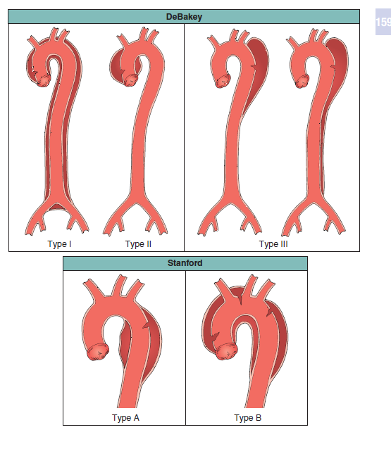

Slide 4
Basic feature
Intimomedial flap TL, FL
-Medial degeneration No Cystic media necrosis
-Typic site highest shear stress
Distal to RCA origin
Distal to subclavian A
-IMH rupture of vasa vas intimal tear .
-PAU
-PAU

Slide 5
complication
- Malperfusion syndromes in territories of aortic side branches
coronary and cerebral or spinal,limb, and/or abdominal ischemia
-Aortic insufficiency possible complication of a type A dissection mechanism multifactorial
-Aortic dissection may rupture into the pericardial,
pleural, and/or peritoneal space
Pericardial tamponade most common cause of death in typeA
Urgent surgical repair rather than pericardiocentesis

Slide 6
Long-Term Changes
If the patient survives, no surgical intervention within 2 weeks of dissection onset, aortic dissection enters chronic phase :
false lumen thrombosis
remains permanently patent.
Thrombosis obliterates the true lumen and allows for reestablishment of physiologic flow confined to the true lumen
False-lumen thrombosis is preceded by blood stasis,(“smoke”) .
Permanent patency of the false lumen is enhanced by the presence of
reentry fenestrations.
Cleaved media of patent false lumen double-barrel aorta
,
progressive weakening of the false lumen’s adventitial wall
secondary aortic aneurysm

Slide 7
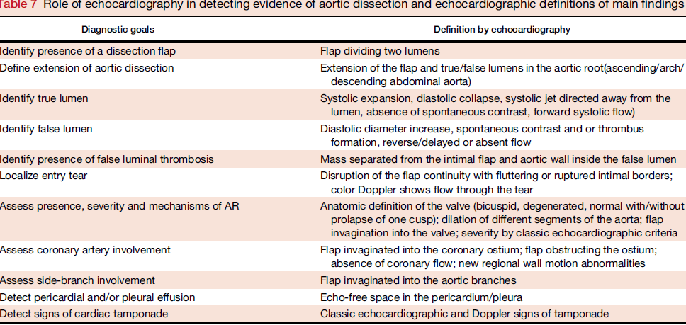

Slide 8
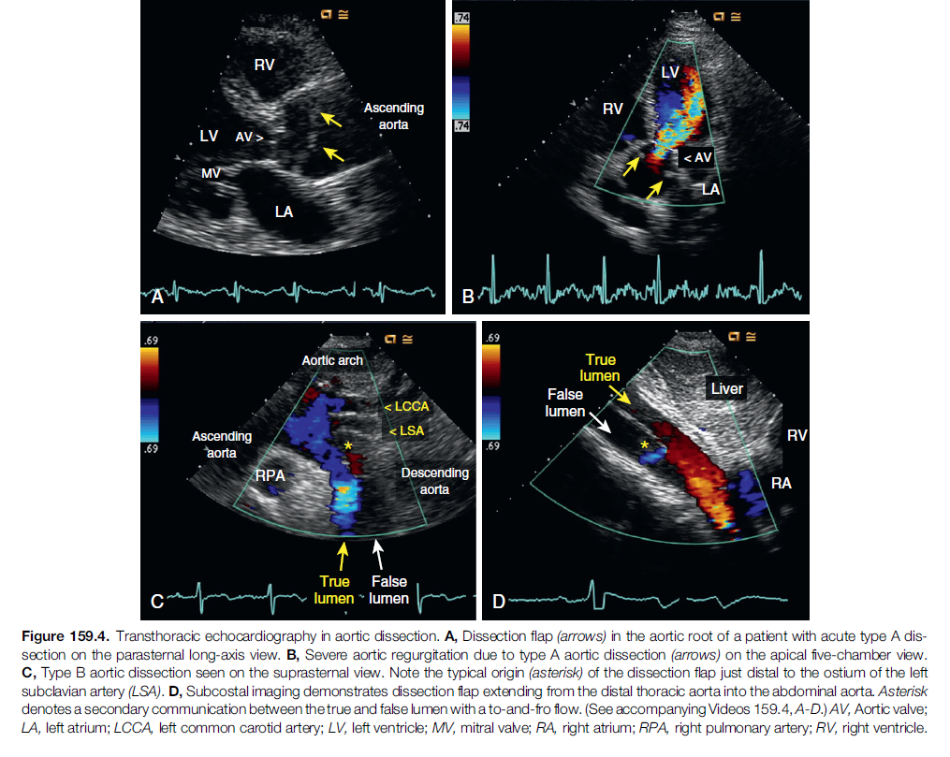

Slide 9
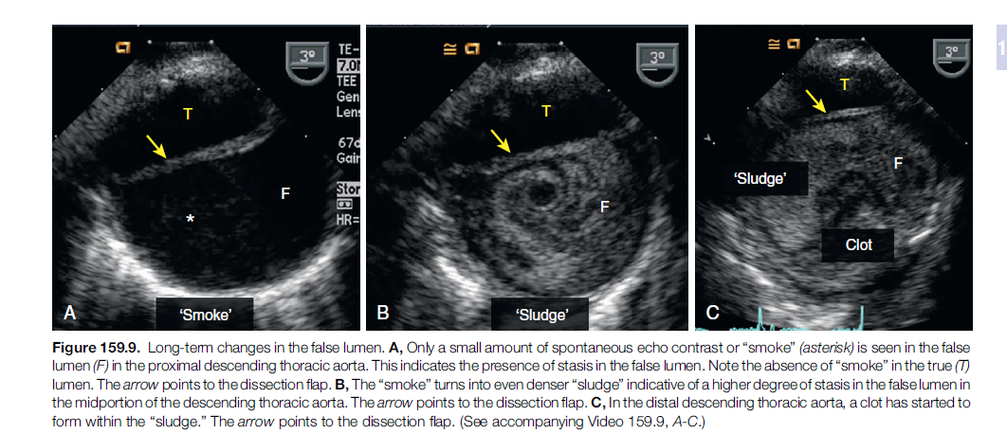

Slide 12
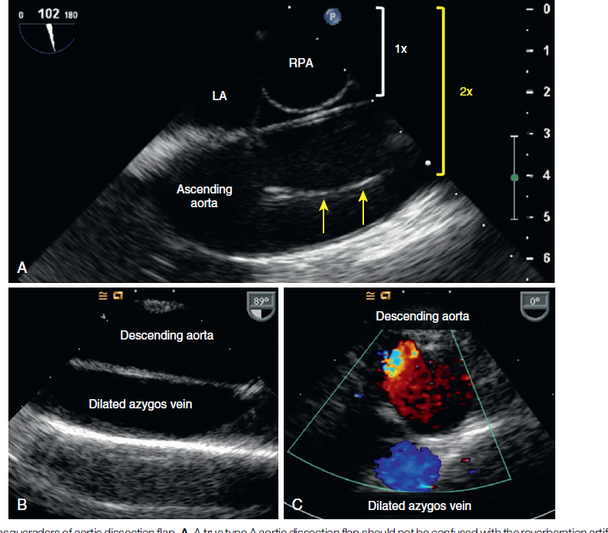

Slide 14
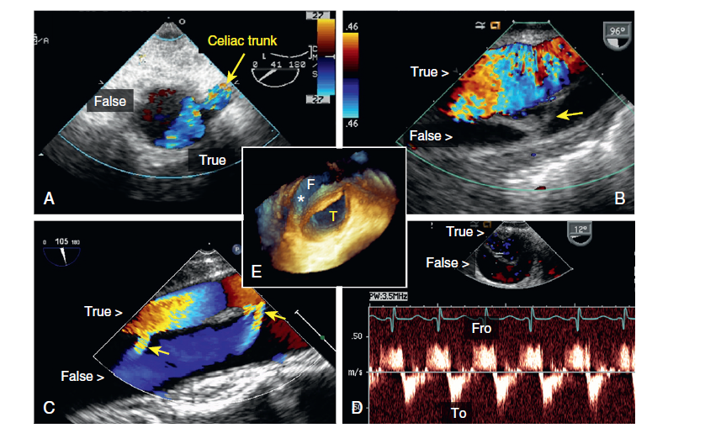

Slide 16
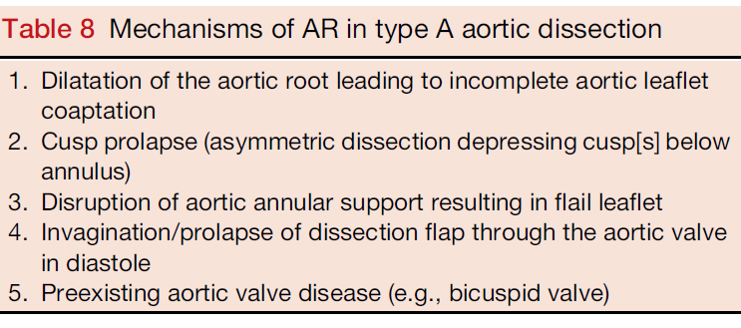

Slide 17
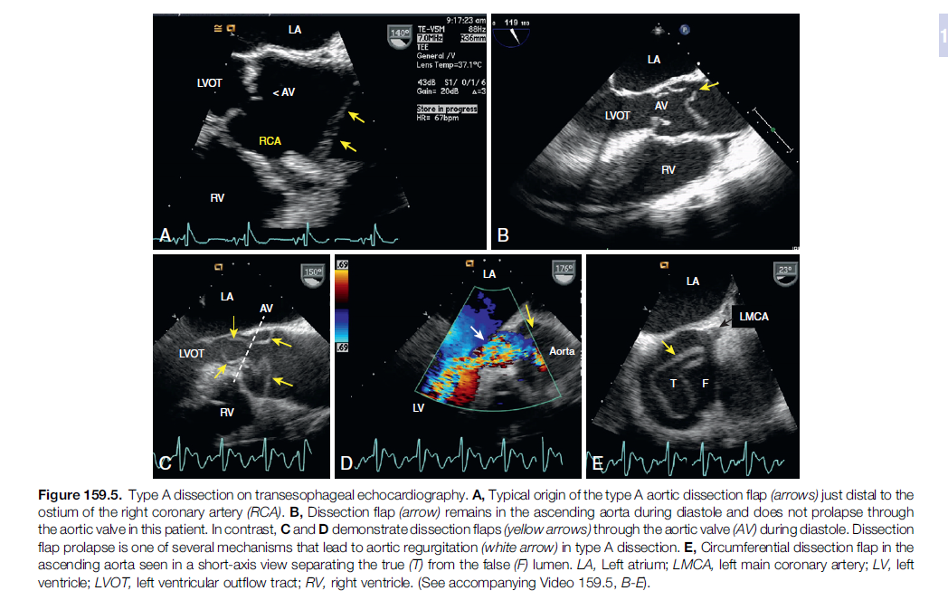

Slide 23
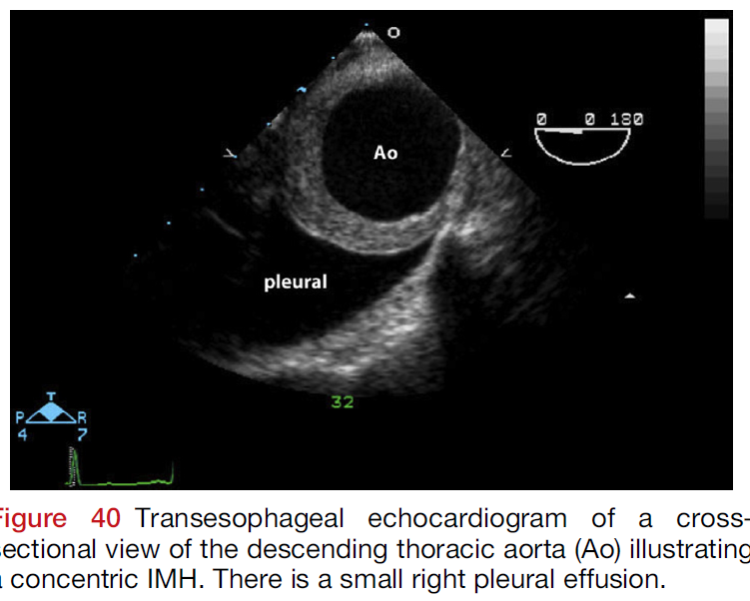

Slide 26
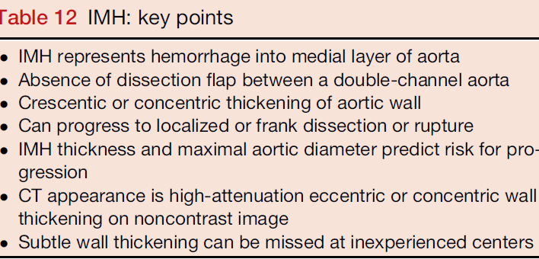

Slide 28
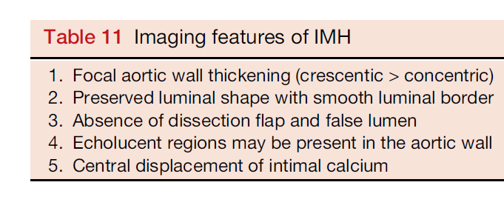

Slide 29
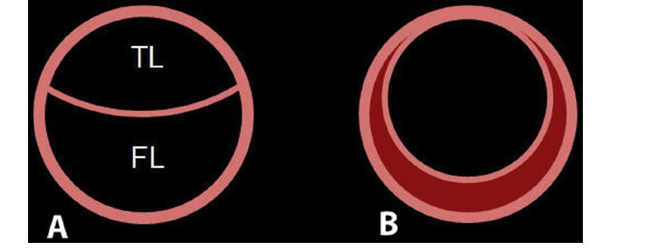

Slide 30
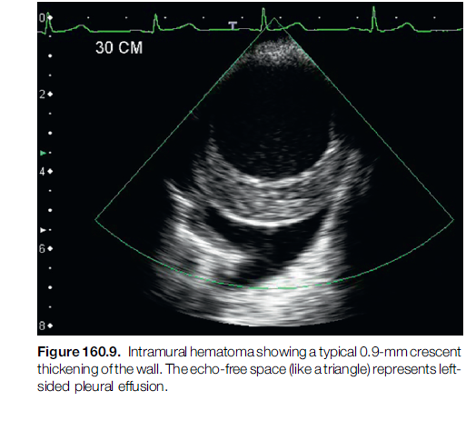

Slide 31
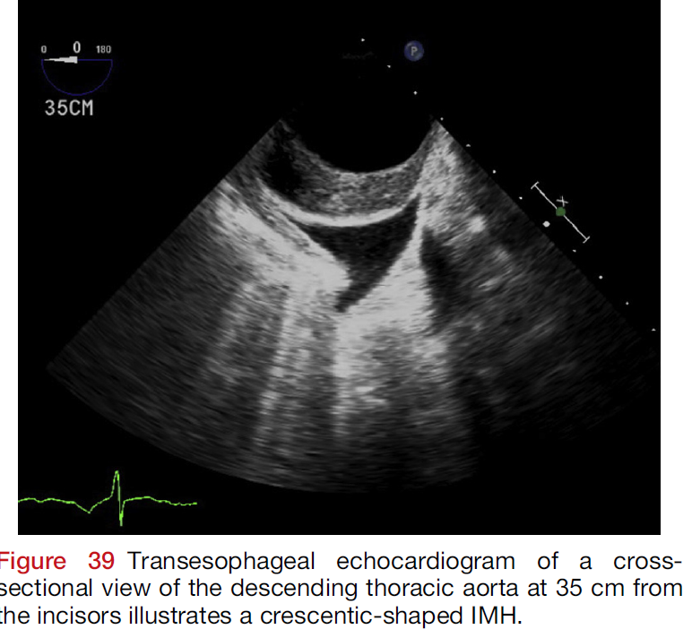

Slide 35
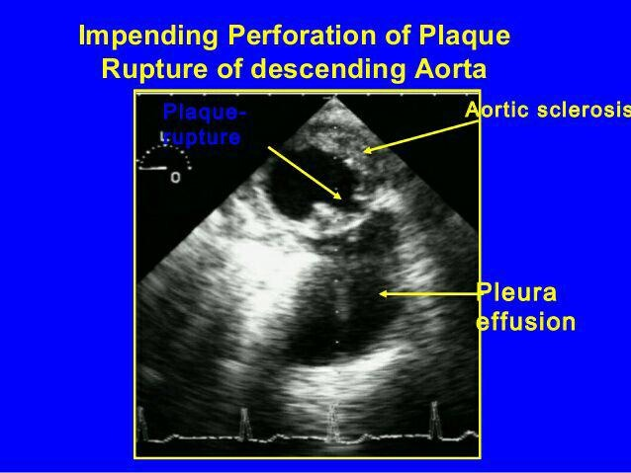

Slide 36
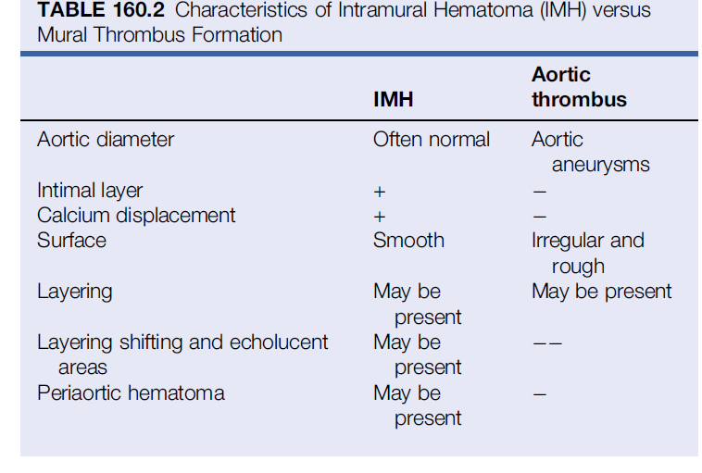

Slide 39
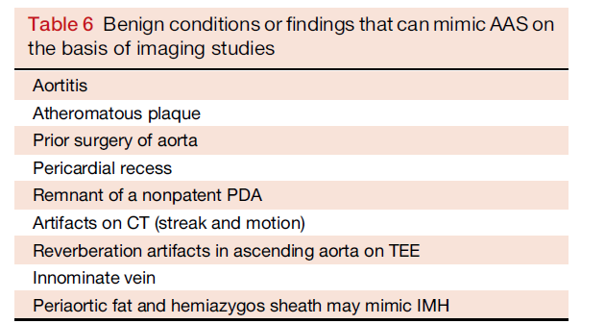

Slide 40
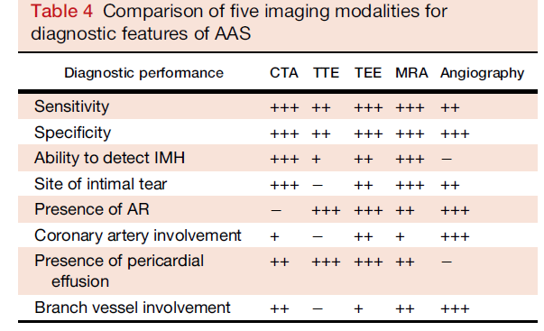

Slide 41
