Slide 1
Therapeutic approach in Cohn's disease
Javad shokri, Babol Medical University
Mohamadjavad Ehsani, Beshti Medical University
Farhad lahmi, Nikan Hospital. Tehran
Saman Alhoee, Babol Medical University

Slide 2
Crohns disease is a lifelong disease, therapy aims to:
Induce remission in the short term
Maintain remission in the long term.

Slide 3
The diagnosis is confirmed by :
clinical evaluation and a combination of endoscopic, histological, radiological, and/or biochemical investigations.
Genetic or serological testing is currently not recommended for routine diagnosis of CD.
A single gold standard for the diagnosis of CD is not available
Journal of Crohn's and Colitis, 2017, 3–25

Slide 4
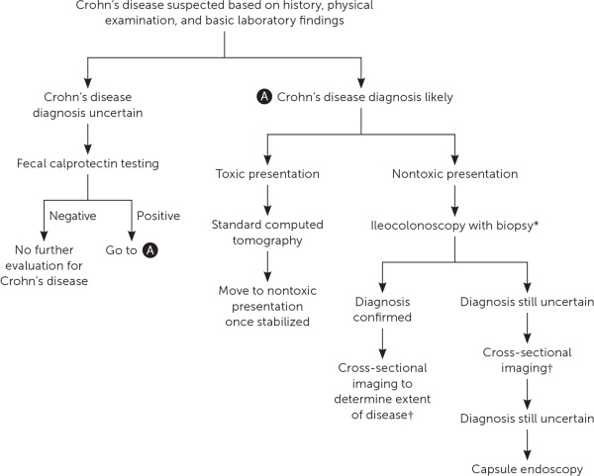

Slide 5
For suspected CD, ileocolonoscopy and biopsies from the
terminal ileum as well as each colonic segment to look
for microscopic evidence of CD are first line procedures
to establish the diagnosis .
Irrespective of the findings at ileocolonoscopy, further investigation is recommended to examine the location and extent of CD in the small bowel
Journal of Crohn's and Colitis, 2017, 3–25

Slide 6
1)Cross-sectional imaging:
MR and CT enterography
2)trans-abdominal ultrasonography (US)
3)Capsule endoscopy
are complementary to endoscopy and offer the opportunity to detect and stage inflammatory, obstructive and fistulising CD.

Slide 7
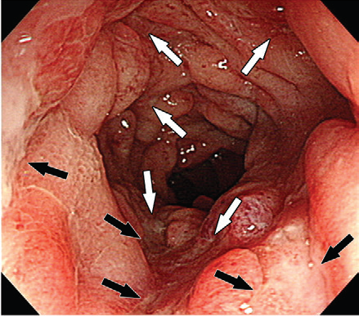
Colonoscopic image of the terminal ileum shows multiple deep
Ulcers and markedly swollen intervening mucosa

Slide 8
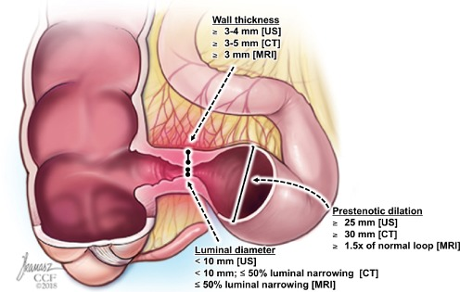
Proposed ranges for key items used for stricture detection in cross-sectional imaging modalities.

Slide 9
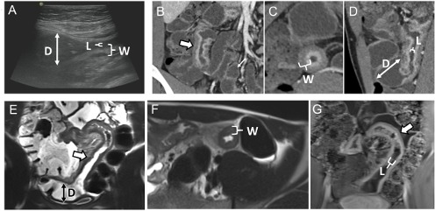
three core items for stricture diagnosis are : wall thickness, luminal narrowing and prestenotic dilation

Slide 10
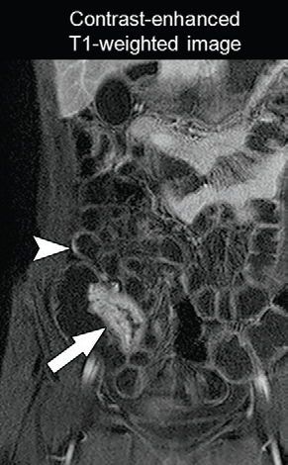

Slide 11
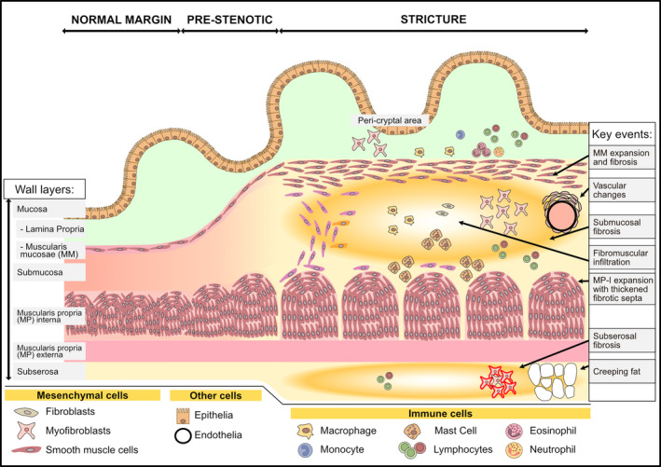

Slide 12
The recognition that chronic and untreated inflammation even if asymptomatic ultimately results in poor outcomes has led to a recent paradigm shift in medical treatment and disease monitoring.
early intervention and intensive monitoring may prevent complication.

Slide 13
Many factors affect the choice of medical therapy.
1)disease location,
2)disease activity and severity,
3)previous response to therapy,
4)presence of perianal or fistulising disease.
5)the individual risk factors for progression and complications,
6)patient’s characteristics,
7)costs and benefit/risk ratio of each drug

Slide 14
Dynamic approach
it is of crucial importance to monitor
disease and therapy at regular intervals based on objective and measurable markers :
Endoscopy
CRP
Calprotectin
Imaging

Slide 15
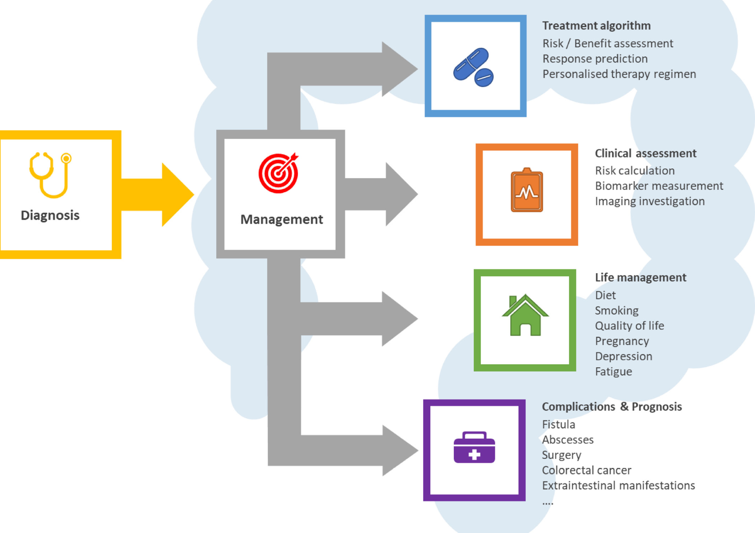

Slide 16
Case based dynamic management of CD
25 y/o female with abdominal pain,diarrhea,, mild anemia
No perianal lesion, no skin lesion, no arthritis.
Pathology: ileitis, no granuloma
Colonoscopy: cecal and ileal aphtus lesion, small ileal ulcers
CRP=13 , Hb=11.5 FC=180
Is it necessary to do more?

Slide 17
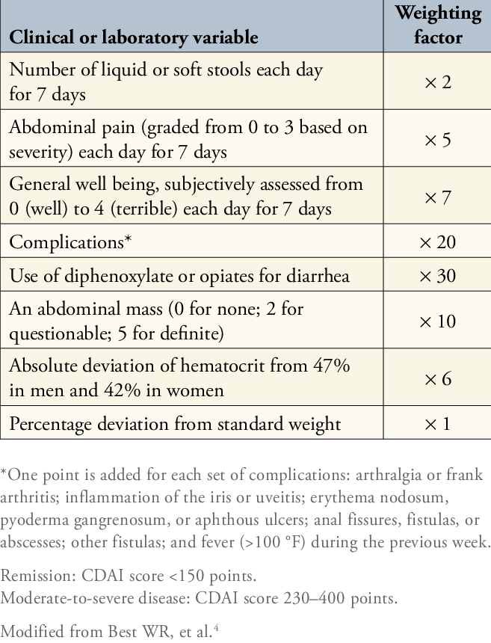

Slide 18
Beginning treatment?
MRE,CT enetrography
entroscopy
capsule endoscopy?

Slide 19
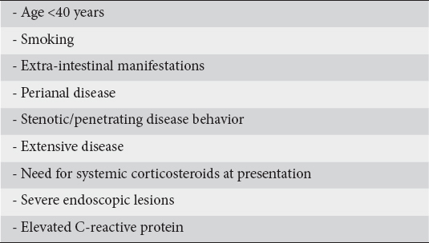
Poor prognostic factors in CD

Slide 21
continue
What treatment ?
5ASA?
Azathioupurine?
Biologic agents?
Budesonide and thioupurins?
Prednisolon?

Slide 22
25mm prednisolon and 50 mg azathioprine. Patients symptoms improved but she stopped and used on demand .
Now came with flare

Slide 23
In recent presentation she suffers
Arthritis, episcleritis, erythema nodosom
severe Weakness and anorexia , no abdominal mass at exam.
No prianal lesion

Slide 24
Patient reported stool pattern
Average abdominal pain rating over seven days
General well being each day over seven days
Complications
Finding of an abdominal mass
Anemia and weight change
 | CDAI Interpretation
0 to 149 points: | Asymptomatic remission
150 to 220 points: | Mildly to moderately active Crohn's disease
221 to 450 points: | Moderately to severely active Crohn's disease
451 to 1100 points: | Severely active to fulminant disease

Slide 25
What is next plan
Colonoscopy?
Cross sectional Imaging as MRE or CT?
Capsule endoscopy?
Enteroscopy?

Slide 26
MR enterography
There was thickening of terminal ileum with mild stenosis about 140 mm in length and 9mm in diameter
What is you next plan
Biologic?
Corticosteroid,
thiuporine?

Slide 27
1)Remicade was started 5mg/kg as IV infusion 0,2,6 then every 8 weeks. 2)azathioprine 1mg /kg

Slide 31
After two months all symptoms improved ,
How to monitor the treatment?
Colonoscopy?
Stool calprotectin?
Drug and antibody level?
Clinical assessment?

Slide 32
How long you continue the treatment ? And which drug should be discontinue first?

Slide 33
Some patients with CD ask their doctors about surgery what situation you think about surgery?

Slide 35
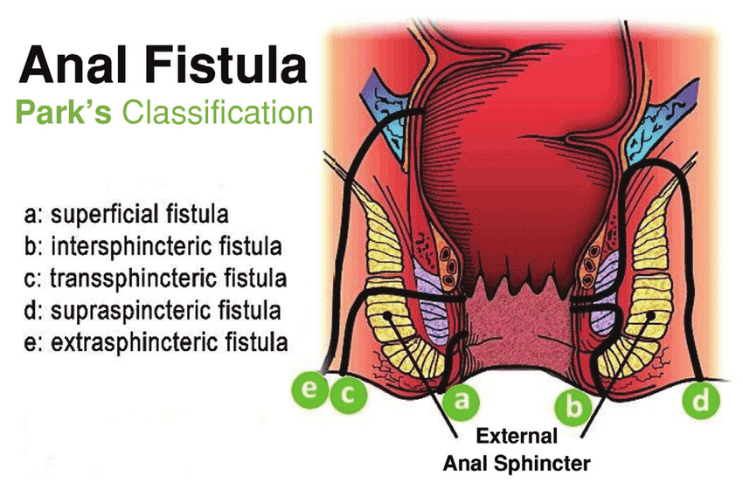

Slide 36
complex fistula
a fistula meeting any of the following criteria:
High location (high intersphincteric, high transsphincteric, extrasphincteric, or suprasphincteric),
multiple external openings
Perianal abscess
anal stenosis
proctitis

Slide 37
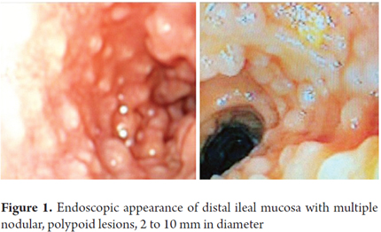

Slide 38
